Slide 1
REU Week 1
Ivette Carreras
UCF

Slide 2
What I have learned this week
Derivatives and Filters (Gaussian)
Optical Flow
Pyramids
Convolution operation
Edge detectors (Roberts, Sobel, Canny)
Sift, interest points and descriptors
Adaboost, face detection
SVM
Bag of features, Kmeans
Great improved Matlab skills

Slide 3
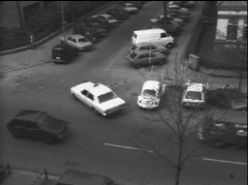
Optical Flow without Pyramid

Slide 4
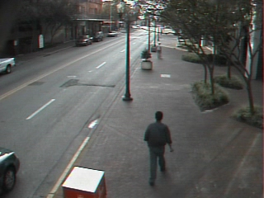
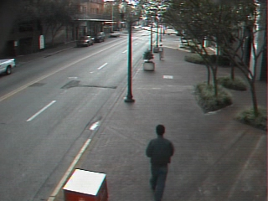
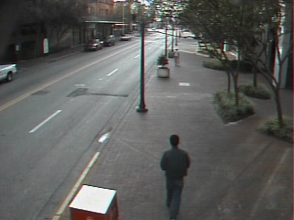
Optical Flow with Pyramids (four Level)

Slide 5
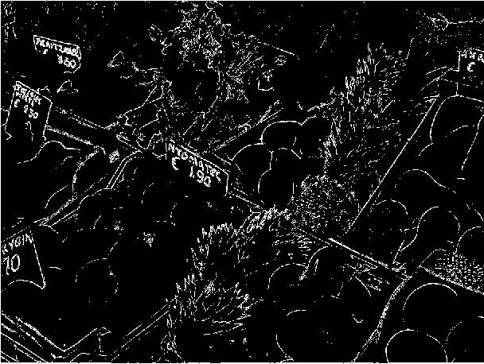
Edge Detectors: Robert
Matlab
function
My function
Same Threshold

Slide 6
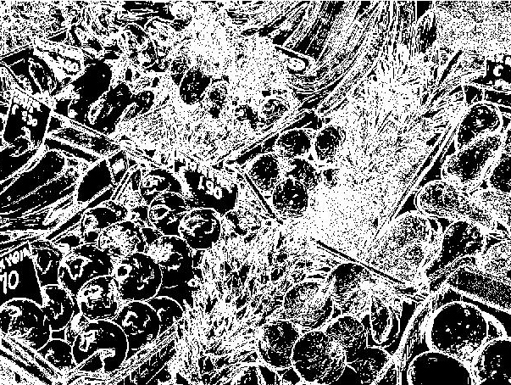
Edge Detectors: Sobel
Matlab
function
My function
Same Threshold
With a
Gaussian
Filter
Sigma:1.5

Slide 7
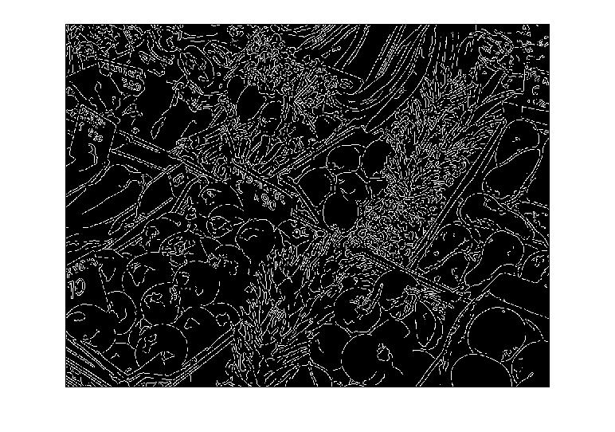
Edge Detectors:Canny
Using the Matlab function

Slide 8
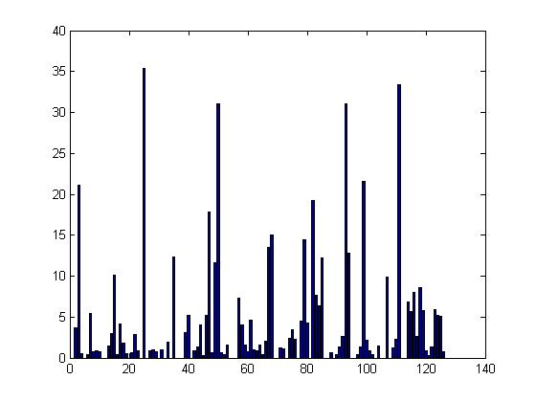
SIFT Descriptor
Descriptor of the point (8,8)
Using vl_sift
Descriptor of the a patch that contains the
point (8:9,8:9) as center
Discrepancy:
Sigma used
Point specification

Slide 9
Bag of Words
Tested in a sample of 37 images of the Oxford 5K
First the key points and descriptors are found
Then the clusters are computed (words)
The clusters are found using the Square Euclidean distance
Used VLFeat implementation and Kmeans function in Matlab
Descriptor for these images: 101246
Designated 10 words for this vocabulary

Slide 10
First three dimensions of the ten words
Word

Slide 11
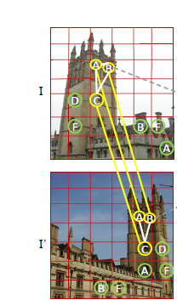
My possible project
Visual Phrases
Using spatial information to relate words and obtain a better match
Describing Images Through Words
Tags, captions, and descriptions of images from the web can be used to produce a relevant caption of what is going on in a query image

