Slide 1
Visual Phrases
Ivette Carreras
Haroon Idrees

Slide 2
Progress so far
Implementation of Bag-of-words
Baseline
Oxford 5K (5062 images, 17 categories + distractors)
GT for 11 landmarks, retrieval problem
VLfeat to extract SIFT features
Build vocabulary of 1000 words
BoW representation for all images
Working on: extracting landmarks, ranking with RANSAC

Slide 3
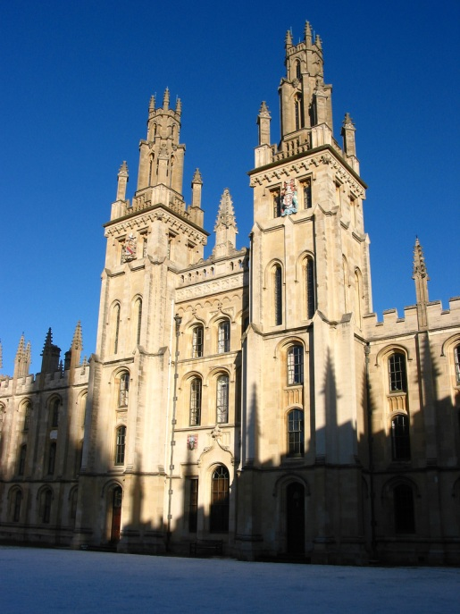
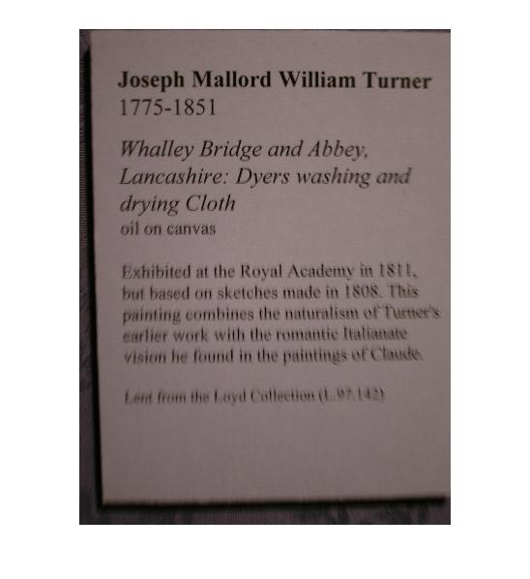
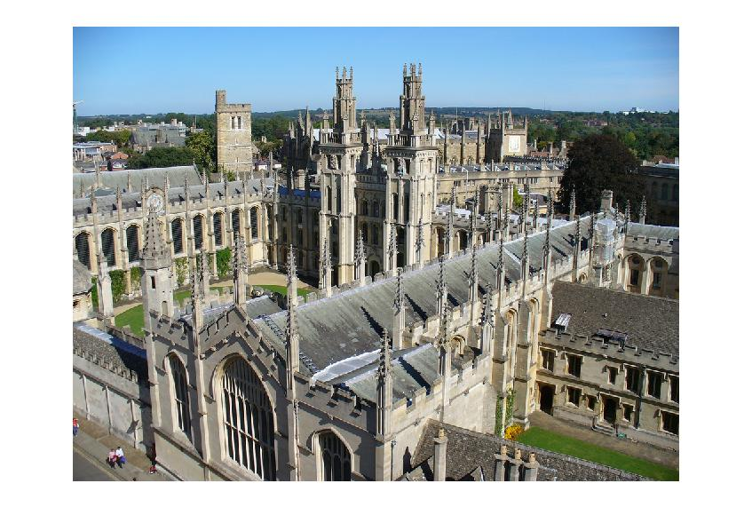
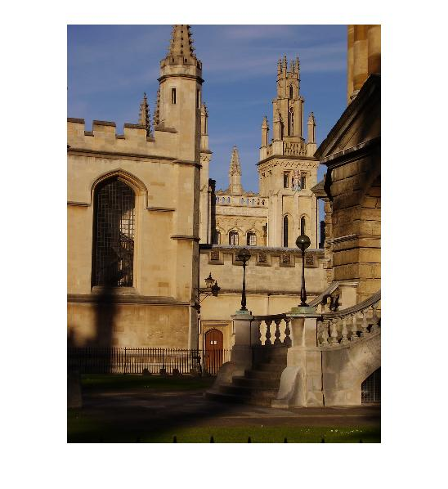
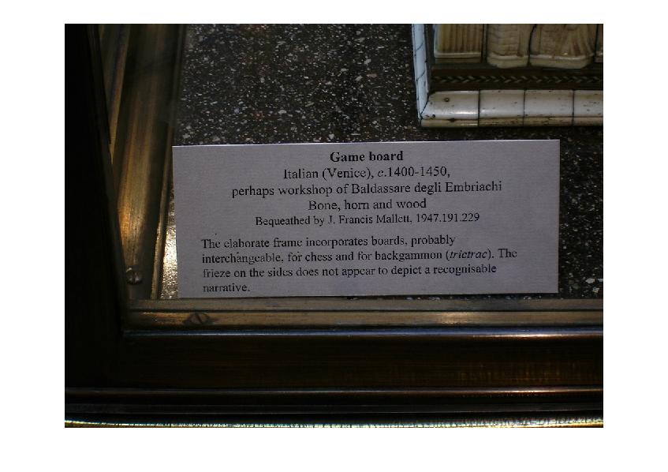
Results 5/8 Good Matches

Slide 4
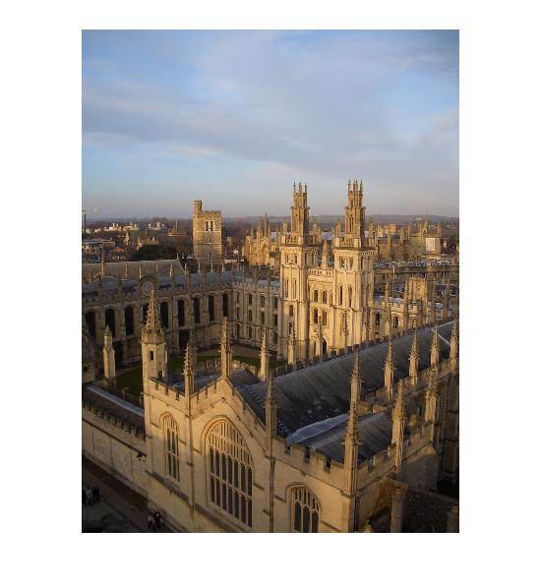
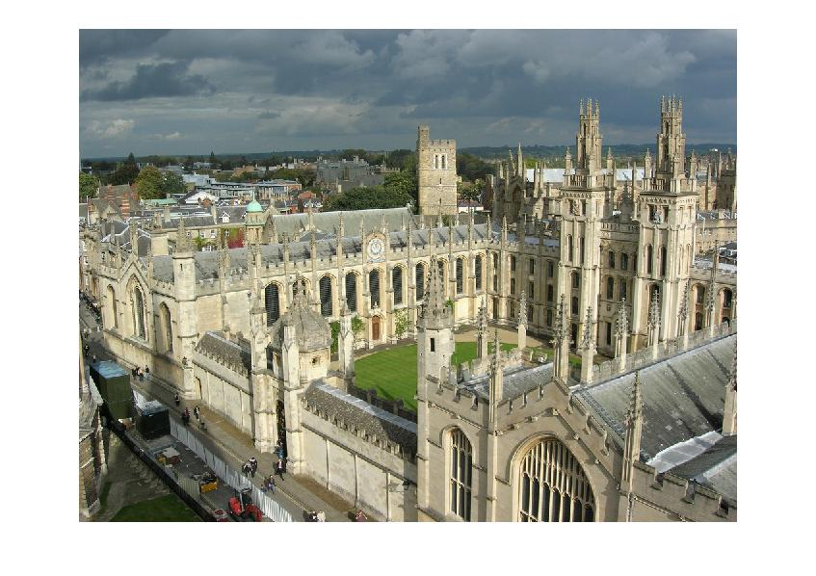
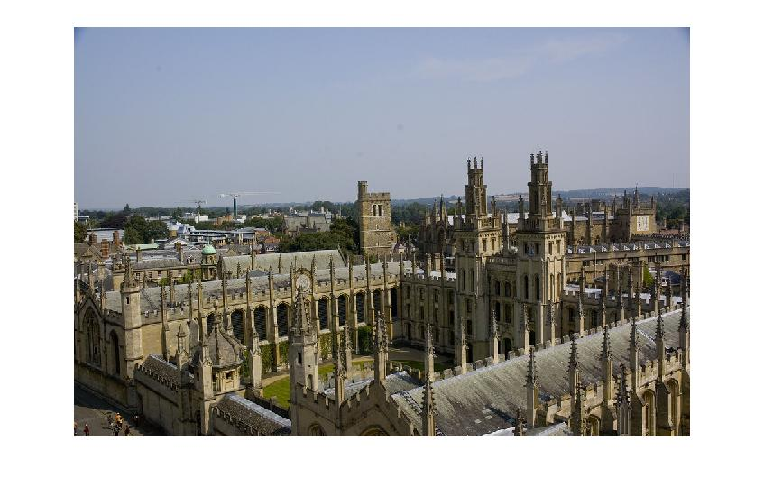
Results

Slide 5
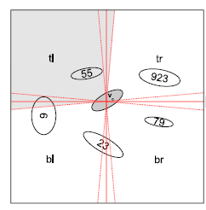
Proposed direction
Frequent Itemset Mining
Transactions capture spatial information between words
Explore ways to incorporate spatial information
Hierarchical mining for longer phrases

Slide 6
Second Idea
Classification
Treat mined phrases as weak classifiers
Find weights based on classification ability in a Adaboost style framework

