Slide 1
Visual Phrases
Ivette Carreras
Haroon Idrees

Slide 2
Selecting features to build phrases
Experiment in landmark 1, 132 Images
Features with high scale – top 50%
Resulted in very short phrases: length 1-3 only
All features regardless of scale
Resulted in longer phrases: length 1-7

Slide 3
Steps to follow
Go through every feature of every image and build the transactions
Mine the resulting file
Read and sort the found phrases by their frequency
Select a percentage for the top frequency
Currently using 20%

Slide 4
Steps to follow
Go through all the features of every image and find a match for a given phrase
Count the phrases in an image and build the Bag of Visual Phrases

Slide 5
Current Status
Obtained transactions for all images
Mined them with different minimum supports
Min_support | Length | Sets found
25K | 2 | 983
15K | 2 | 3896
5K | 3 | 4549
2.5K | 5 | 6139
1.5K | 5 | 8755
500 | 6 | 51985

Slide 6
Min_supt 500 Frequencies
Phrases | Length | Frequency
42228 | 2 | 500-16354
1964 | 3 | 500-5166
179 | 4 | 500-3597
11 | 5 | 515-2728
1 | 6 | 558
Currently working on building the BoVP for these transactions

Slide 7
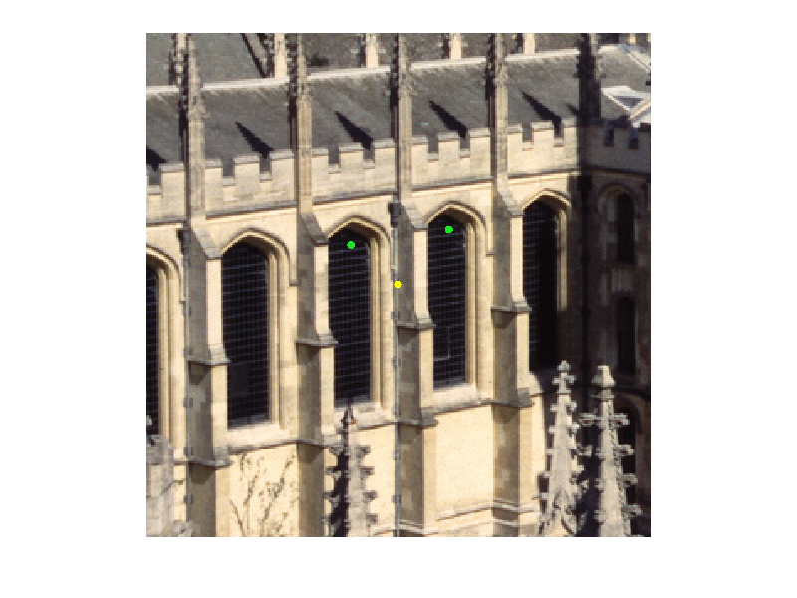
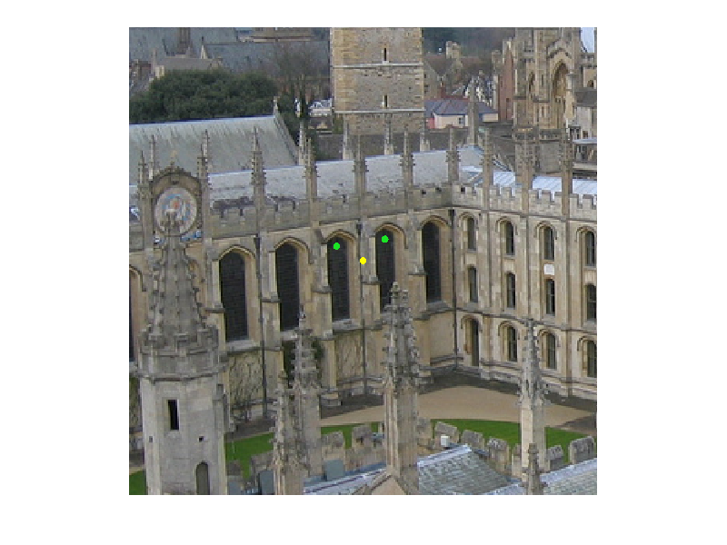
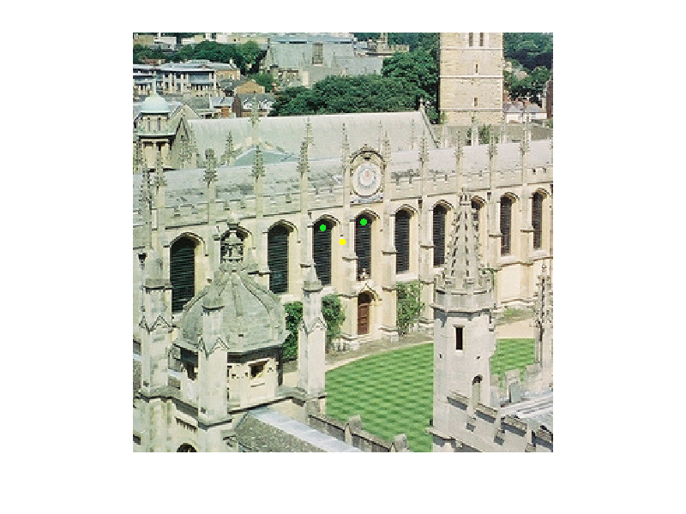
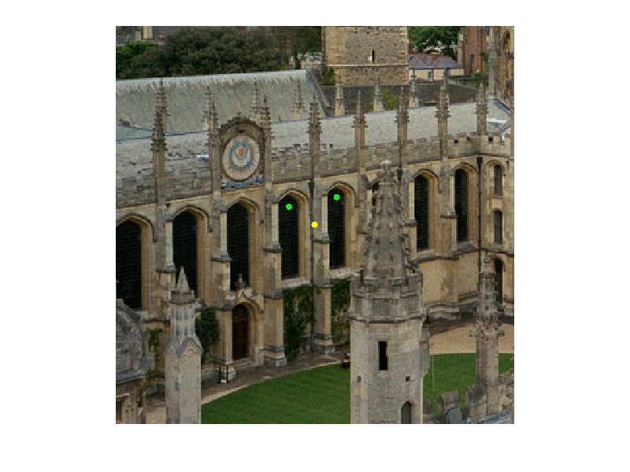
Visual Phrases using Data Mining for 132 Images. Phrase Length 2
2
38
29
37

Slide 8
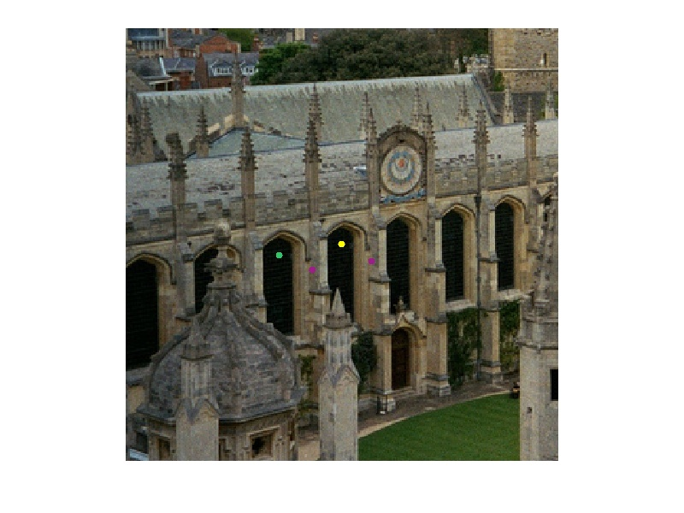
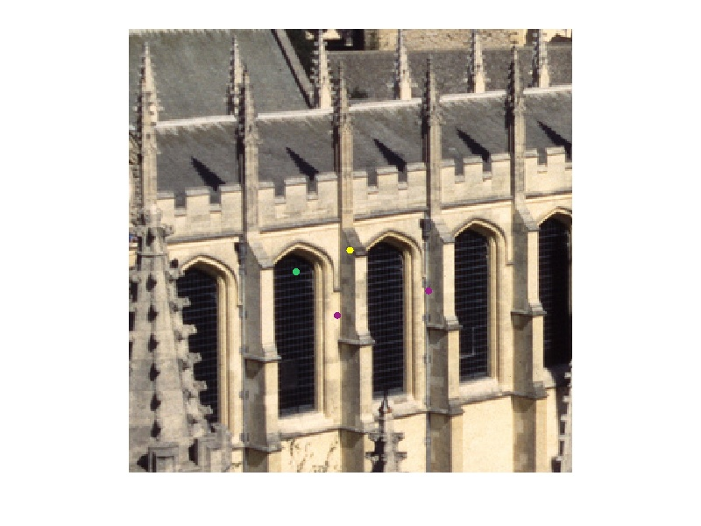
Visual Phrases using Data Mining for 132 Images. Phrase Length 3
29
2

Slide 9
Next Steps
Finish building the Bag of Visual Phrases for all images
Find mAP for BoVP– mean average precision
Compare results from BoW and BoVP
Our 1K BoW – 20% mAP

