Slide 1
Visual Phrases
Ivette Carreras
Haroon Idrees

Slide 2
Current Results
Code Problems – Fixed
BOW – same as the state of the art
BOVP with all phrases with a frequency above 500, 40215
Vocabulary | BOW (mAP) | BOVP(mAP)
1K | 26.95% | 20.97%

Slide 3
Analysis of Phrases
Find phrases that are important
How interesting are short and long phrases?
Which ones to keep?
The experiment shown above uses all of them and with the same weight

Slide 4
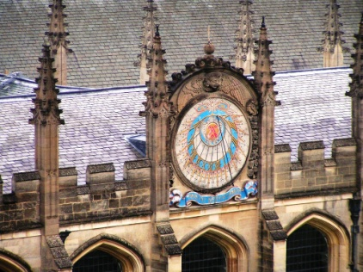
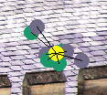
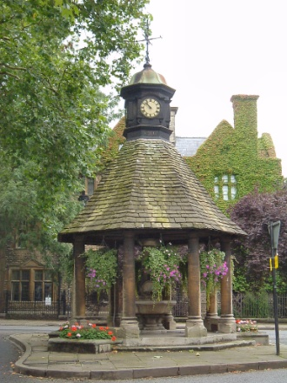
Length 6
Describes bricks

Slide 5
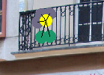
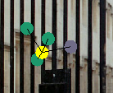
Length 6
Also describes fences

Slide 6
Next steps
Continue analyzing phrases
Experiments to run:
BoVP and BoW mixed
BoVP for 10K
BoVP, radial configuration

