Slide 1
Convolutional Neural Networks with Multiple Channel Features for Human Detection
Jared Rhizor and Baoyuan Liu
University of Nevada, Reno

Slide 2
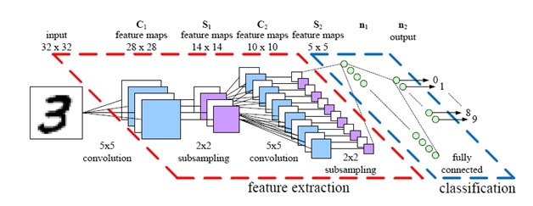
Convolutional Neural Networks
http://parse.ele.tue.nl/cluster/2
Channel Features
RGB
Gradient Histogram
Grad. Mag.
CIELUV

Slide 3
Results
Fast convergence for single channel training

