Slide 1
REU Week 1
Jared Rhizor

Slide 2
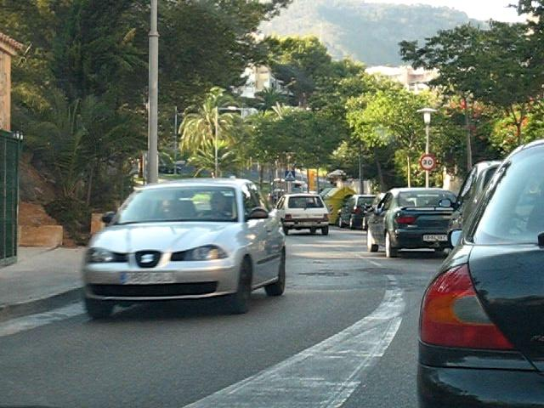
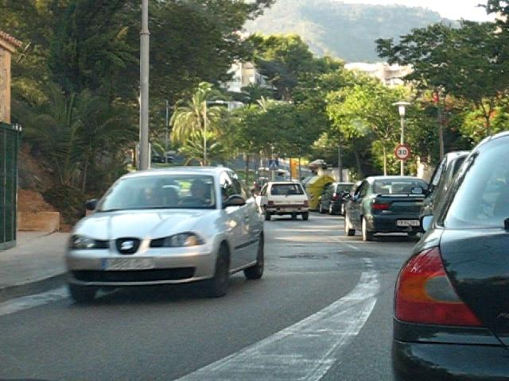
Optical Flow
Create f_{x},f_{y}, and f_{t}
Use the surrounding 3x3 window to compute a vector field at every point.
Iterate until convergence.

Slide 3
Optical Flow

Slide 4
SIFT
0.5522
0.5527
0.5491
0.5414
0.5298
0.5146
0.4961
0.4747
Too similar
0.4847
0.5016
0.5154
0.5260
0.5330
0.5363
0.5358
0.5316

Slide 5
SIFT
0.0787
0.0823
0.0853
0.0879
0.0898
0.0911
0.0917
0.0916
0.0648
0.0334
0.0020
0.0059
0.0118
0.0177
0.1276
0.1748

Slide 6
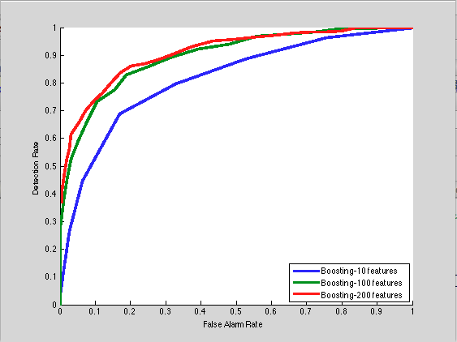
Adaboost

Slide 7
Potential Projects
1. Human Detection Using Convolutional Neural Network (Baoyuan Liu)
2. Face Recognition on the Internet - "Who are you?" (Dong Zhang)
3. Human Detection and tracking in semi-crowded and crowded
scenes using depth-RGB surveillance cameras (Shayan Modiri)
4. Crowd Density Estimation (Afshin Dehgham)
5. Optimal algorithms for topologically constrained point
correspondence (Imran Saleemi)

