Slide 1
REU Week 2
Jared Rhizor

Slide 2
Adaboost
My Feature

Slide 3
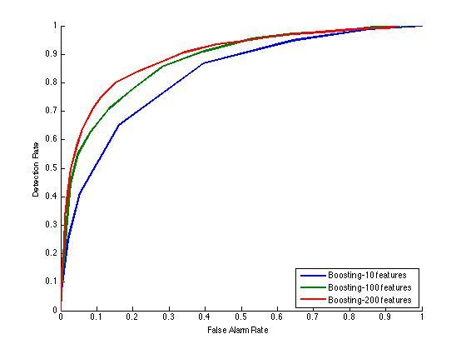
Adaboost
My Feature's ROC Curve

Slide 4
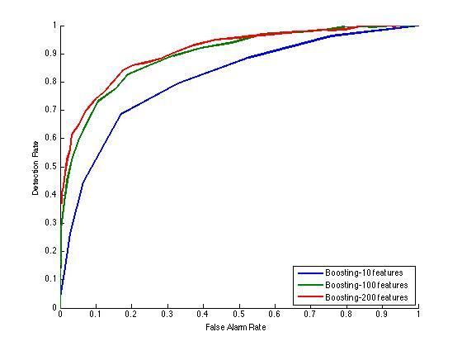
Adaboost
The Provided Features' ROC Curve

Slide 5
Adaboost:
Performance of New Feature
Not as good as the previous four features
Less versatile
Worse localization
But it uses only 2940 total features instead of 32746, making training much faster.

Slide 6
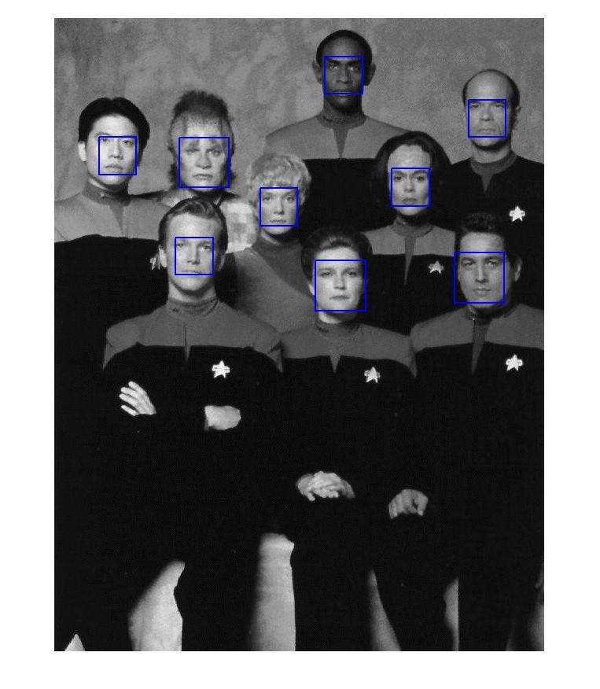
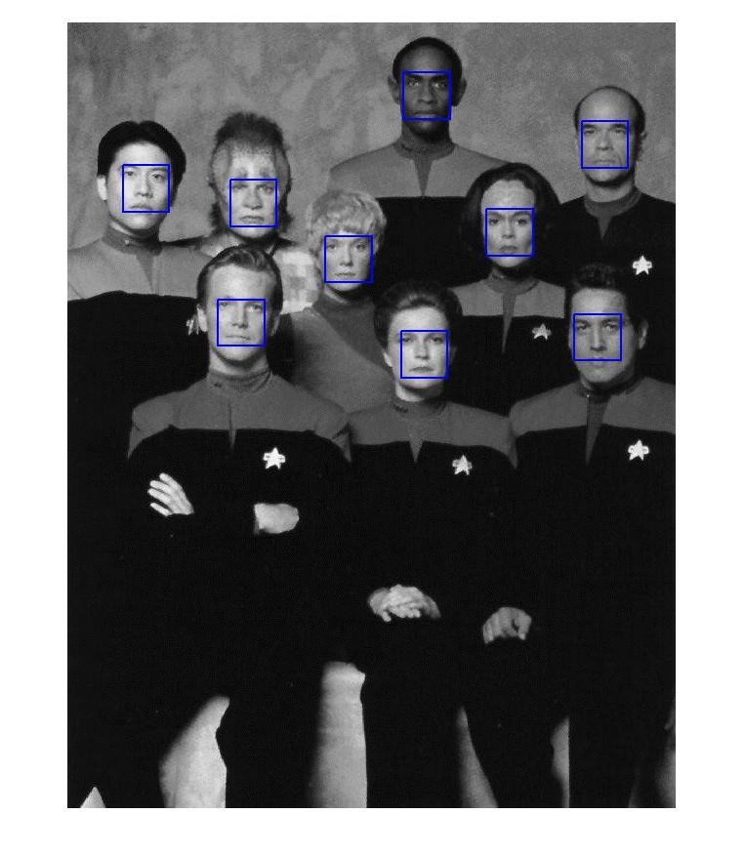
Adaboost:
Performance of New Feature
With a threshold of 48 (instead of 70)

Slide 7
Other Work
SIFT Matching
Project Selection

