Slide 1
REU Week 5
Jared Rhizor

Slide 2
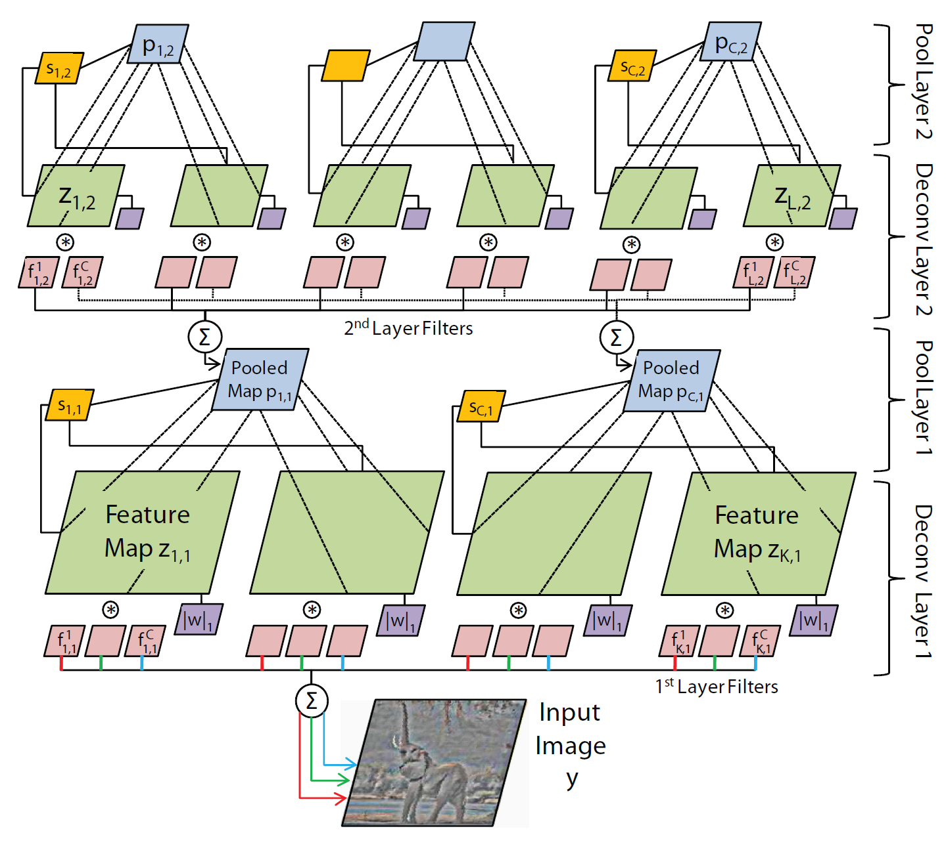
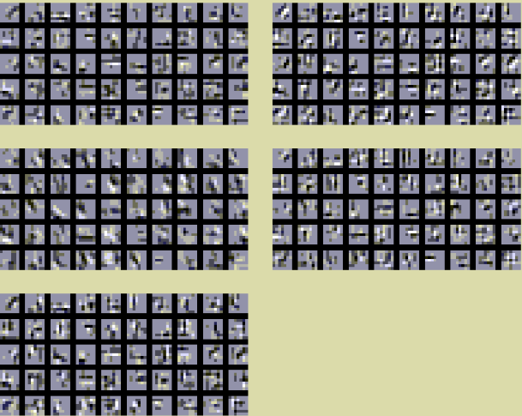
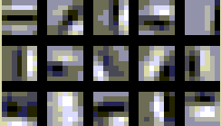
Using the DeconvNetToolbox

Slide 3
Filters from the second layer

Slide 4
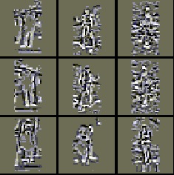
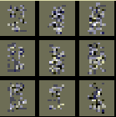
Feature Maps
First level Second level … Fourth level

Slide 5
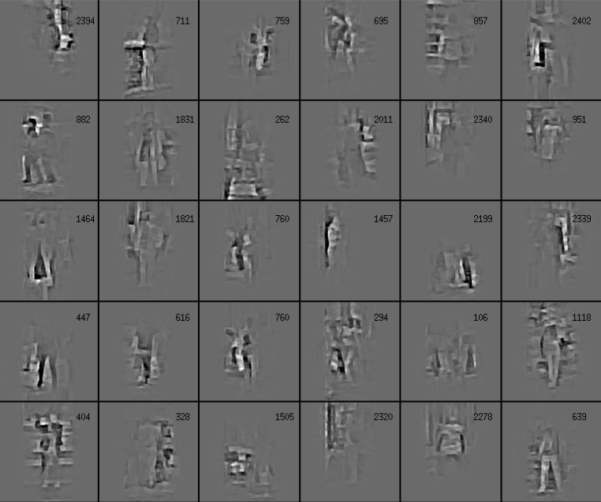
Better method to visualize filters

Slide 6
Detection
Sliding window applied on different scales.
Compute the descriptor at every window.
We need to know how to generate the descriptor using Spatial Pyramid Matching.

Slide 7
Dataset
INRIA Person Dataset
Cropped and centered images for training the deconvolutional neural network for learning how to construct descriptors.
Random windows from the negative examples to train the SVM (we are using libSVM for this).

Slide 8
This week
Learn how to generate the descriptor
Gather basic human detection results
Compare performance using representations from different levels.
Rotational Invariance
The CNN papers we found do not actually guarantee rotational invariance.
Dr. Bebis will be able to talk to us on the 15th.

