Slide 1
Crowd Density Estimation Using Eulerian Particle Dynamics
Paul Finkel
UCF Computer Vision REU 2012
7/31/12

Slide 2
Dense Crowds
Dense crowds move similar to fluids
Uniform direction of movement
Uniform velocity
Calculate the correlation between specific regions (Eulerian approach)
Separate low and high dense crowd regions.
Segment regions of crowd and extract features
Area, perimeter, edge orientation, etc.

Slide 3
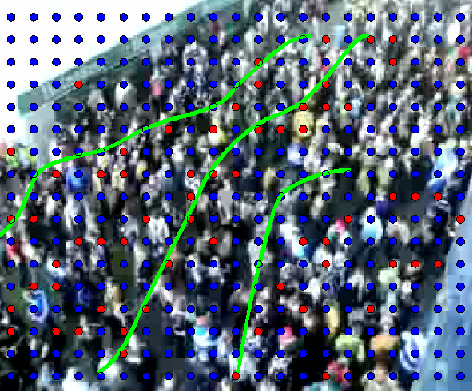
Segmented Crowd Regions

