Slide 1
UCF Computer Vision REU 2012 Week 1 Presentation
Paul Finkel
5/21/12

Slide 2
Accomplishments
Working version of the Lucas Kanade optical flow algorithm
Semi-working version of the Lucas Kanade optical flow algorithm with pyramids
Algorithm to obtain 128-dimensional SIFT descriptor from 18x18 patch of image

Slide 3
Lucas Kanade Optical Flow Difficulties
Understanding that you didn’t have to loop through the images to calculate fx, fy, or ft, but you did have to loop through every 3x3 grid of pixels to calculate 1 u and 1 v value.
Quiver flips the image over the horizontal axis
Making the A matrix correctly
Had to transpose before flattening

Slide 4
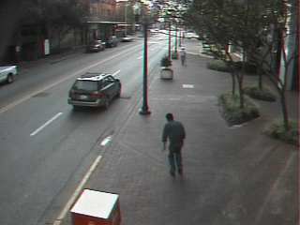
Original Image 1

Slide 5
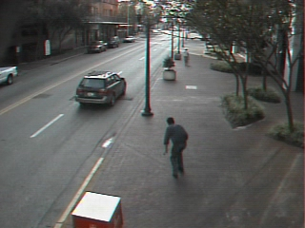
Original Image 2

Slide 6
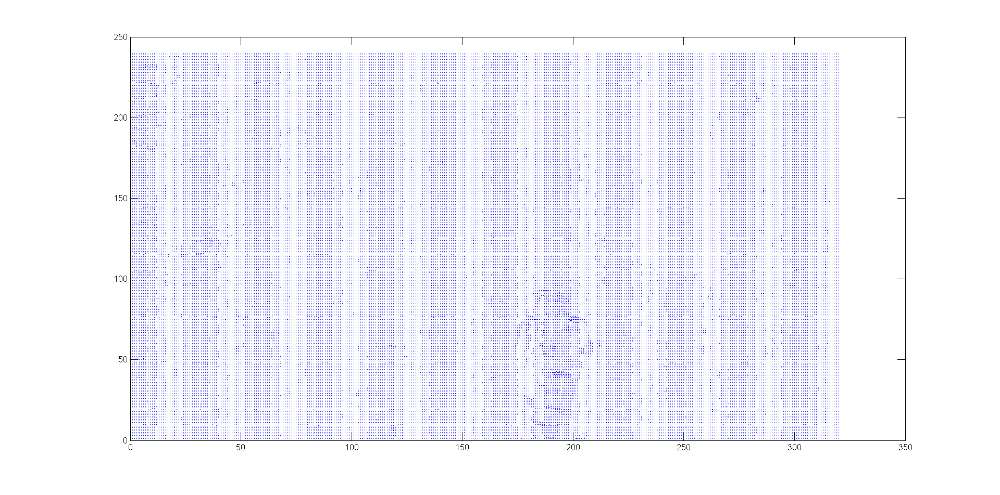
Quiver Representation

Slide 7
flowToColor Representation

Slide 8
Optical Flow w/ Pyramids Difficulties
Doesn’t quite work
Low resolution > medium resolution > high resolution
Obtaining ft
Can’t make entire ft matrix in one go because each value of ft is dependent on the position in the image and the lower level of resolution’s u and v values
Expanding u and v matrices, as well as images

Slide 9
Optical Flow w/ Pyramids Difficulties (cont’d)
Dealing with non-integer indices
Decided to round indices
Could have also used bilinear interpolation
Dealing with out of bounds indices due to larger u and v values, either positive or negative

Slide 10
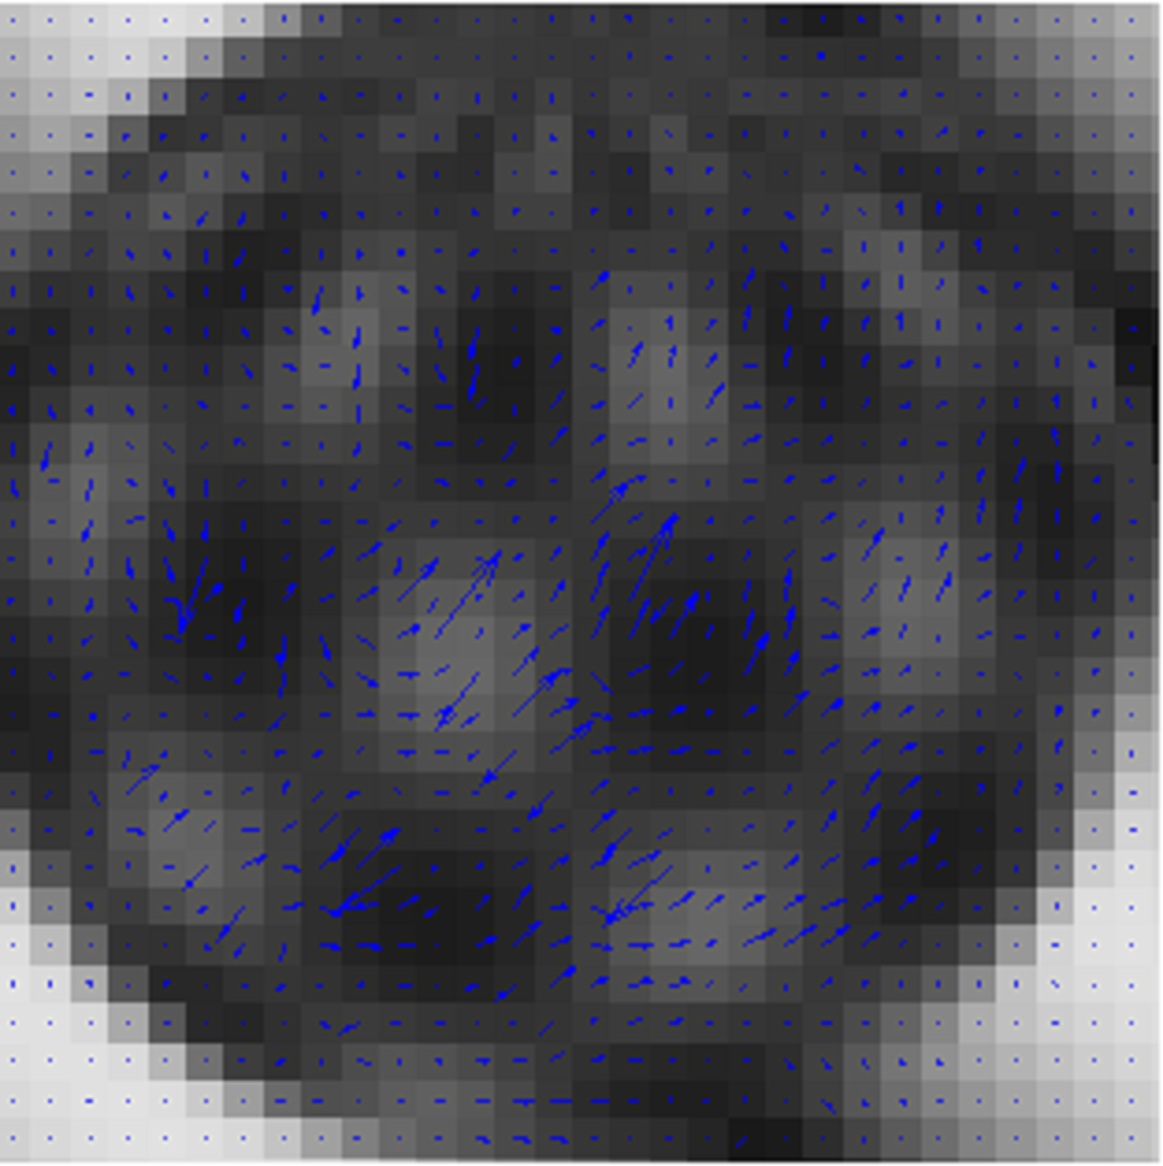
Low Resolution of Pyramids

Slide 11
Medium Resolution of Pyramids

Slide 12
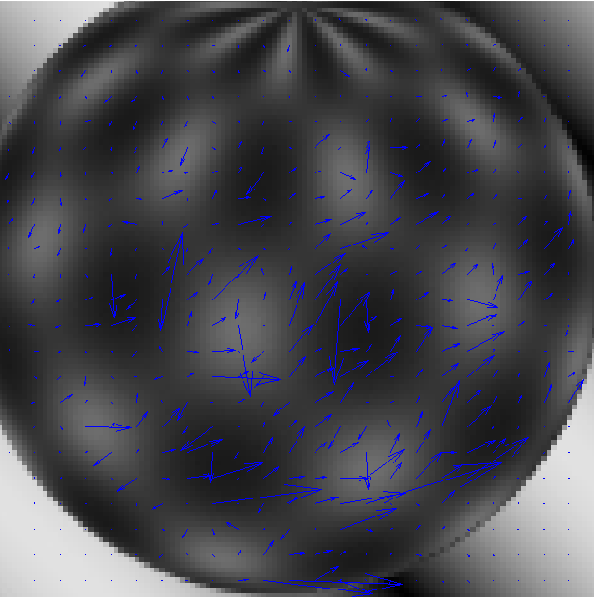
High Resolution of Pyramids

Slide 13
SIFT Difficulties
Rotational invariance
Had to add modular arithmetic
Sift descriptor isn’t exactly the same with different orientation angles, but most of them are the same, just shifted
All of them should be the same
Slight differences in bin magnitudes

Slide 14
SIFT, orientation angle = 0
>> desc(1:8,:)
ans =
0.3743
2.0477
22.9537
0.1946
0
0
5.8930
0.7933

Slide 15
SIFT, orientation angle = 2*pi
>> desc(1:8,:)
ans =
0.3743
2.0477
22.9537
0.1946
0
0
5.8930
0.7933

Slide 16
SIFT, orientation angle = pi/4
>> desc(1:8,:)
ans =
2.0477
22.9537
0.1946
0
0
5.8930
0.7933
0.3077

Slide 17
SIFT, orientation angle = pi/4+2*pi
>> desc(1:8,:)
ans =
2.0477
22.9537
0.1946
0
0
5.8930
0.7933
0.3077

Slide 18
SIFT, orientation angle = pi/4+4*pi
>> desc(1:8,:)
ans =
2.0477
22.9537
0.1946
0
0
5.8930
0.7933
0.3077

