Slide 1
Crowd Density Estimation Using Eulerian Particle Dynamics Weeks 9 & 10
Paul Finkel
UCF Computer Vision REU 2012
7/24/12

Slide 2
Read Papers to Find Algorithm for Counting
Read papers discussing crowd density estimation
Not good for highly dense crowds
Occlusion
Segmentation

Slide 3
Read Papers to Find Algorithm for Counting
Privacy Preserving Crowd Monitoring: Counting People without People Models or Tracking (Antoni B. Chan, Zhang-Sheng John Liang, Nuno Vasconcelos, CVPR 2008)
Preserves privacy
Specifies features of regions that are used to calculate density

Slide 4
Video 1

Slide 5
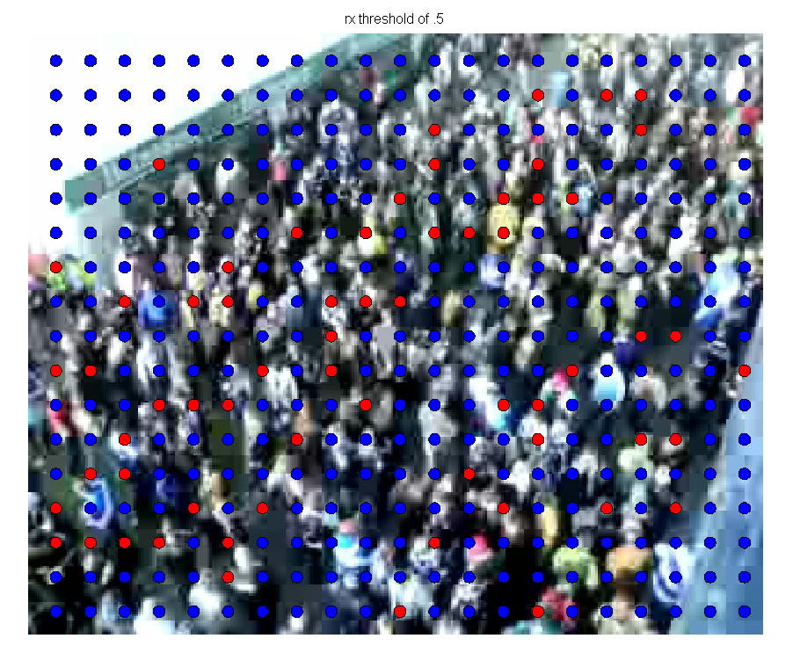
Correlation, Video 1

Slide 6
Motion Boundaries, Video 1, Manual

Slide 7
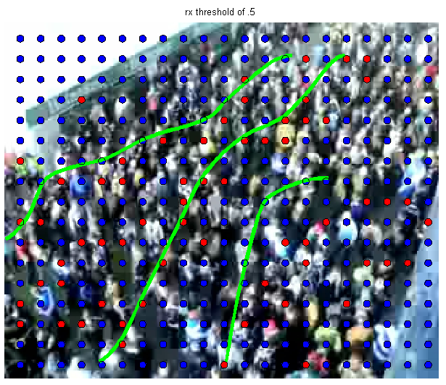
Motion Boundaries, Video 1, Automatic

Slide 8
Masks, Video 1

Slide 9
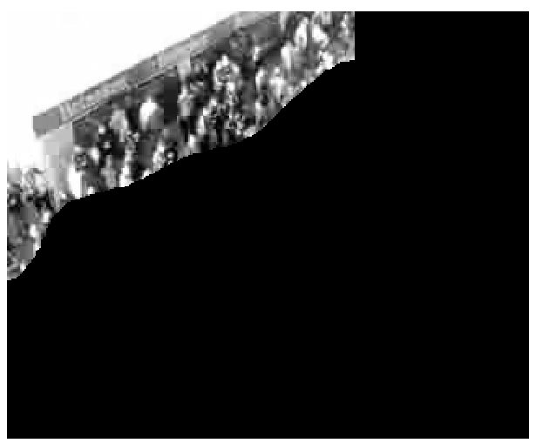
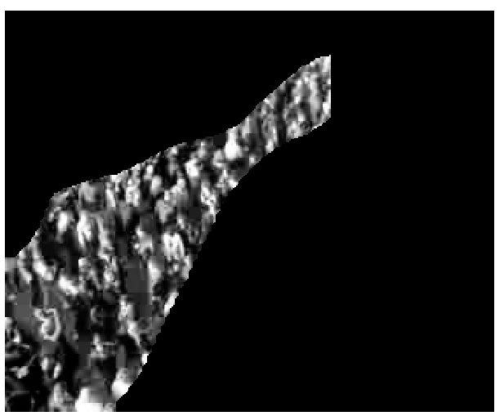
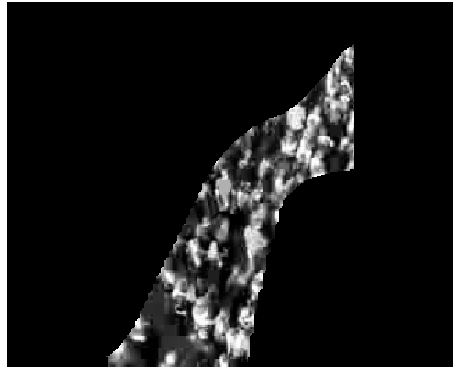
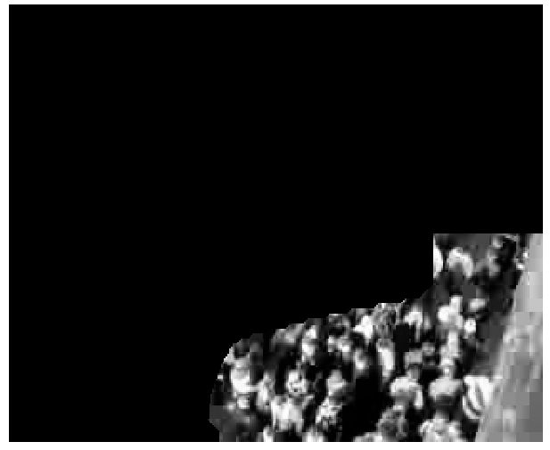
Extracted Regions, Video 1

Slide 10
Video 2

Slide 11
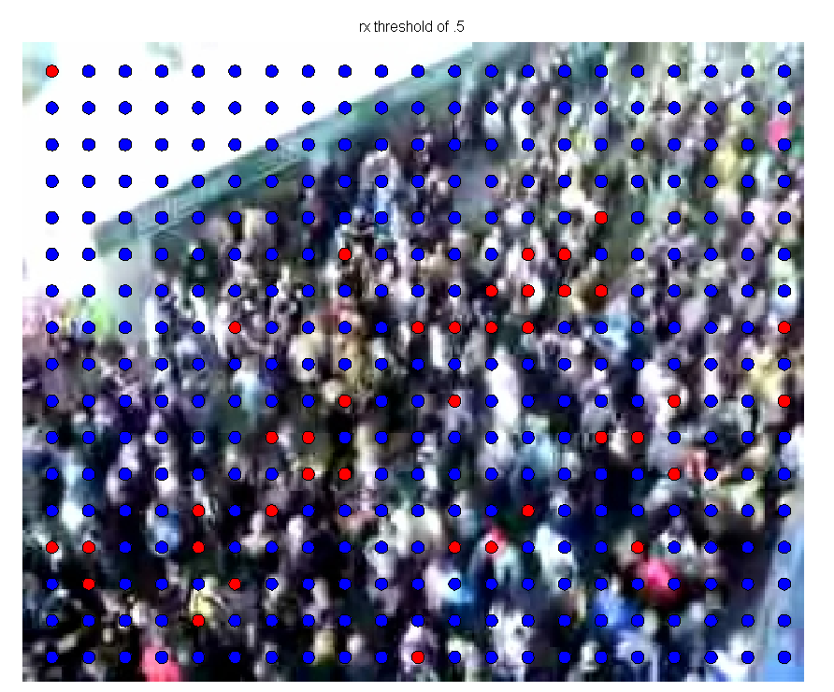
Correlation, Video 2

Slide 12
Motion Boundaries, Video 2, Manual

Slide 13
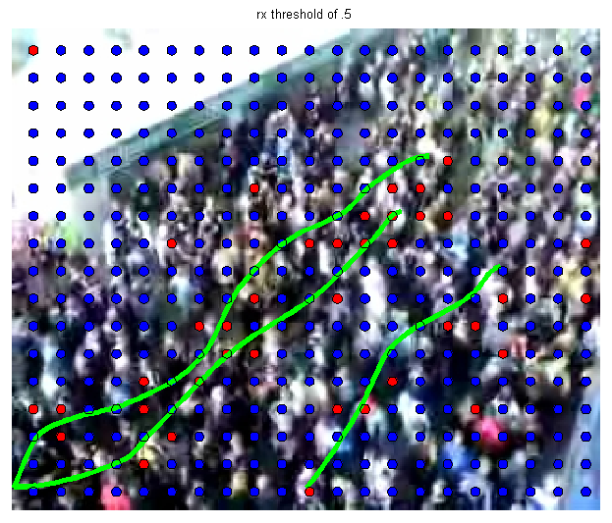
Motion Boundaries, Video 2, Automatic

Slide 14
Masks, Video 2

Slide 15
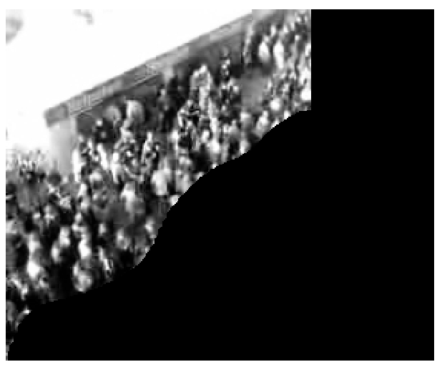
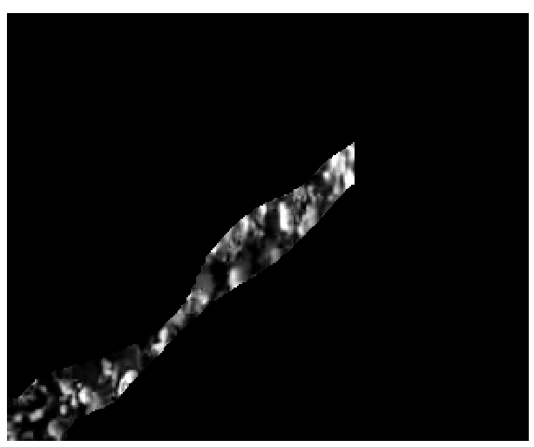
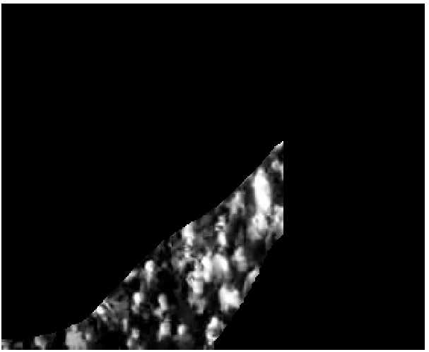
Extracted Regions, Video 2

Slide 16
Feature Extraction
Segment features (area, perimeter, perimeter edge orientation, perimeter-area ratio)
Internal edge features (total edge pixels, edge orientation)
Texture features

