Slide 1
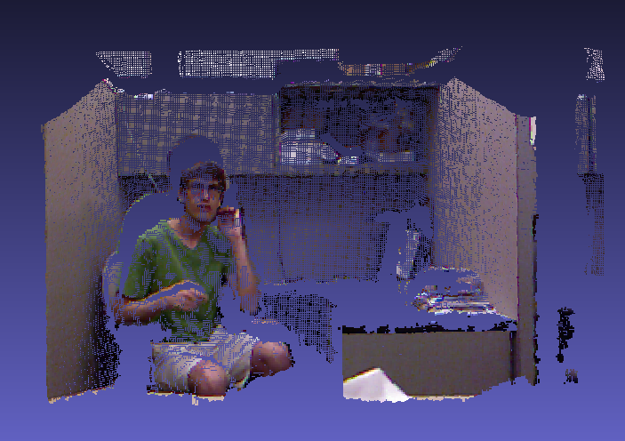
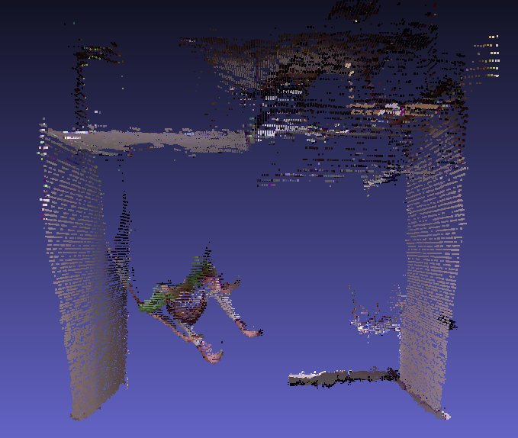
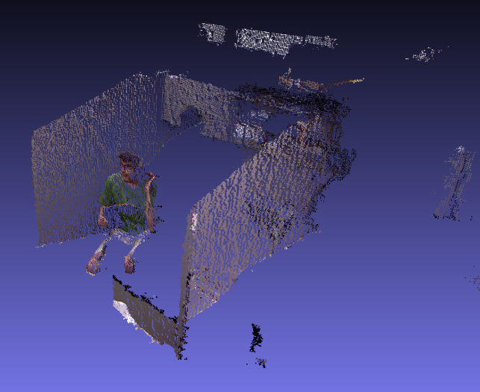
Steven Hickson Efficient Hierarchical Graph-Based Segmentation of Spatio-Temporal Volumes
Problem
Image and Volume Segmentation:
Group together similar pixels or voxels into regions that exhibit coherence, both spatially and visually.
Use both temporal and spatial information to improve segmentation.
Our Approach
Robust segmentation algorithm that uses 3D or 4D data (Microsoft Kinect data).
Novel hierarchical volumetric segmentation applicable to images, cloud points, and their temporal changes with no video length limit.
Highly efficient. Processing time for 4D data is near real time (~3 frames per second)
Applications: Object detection, activity recognition, and automatic selection of interesting objects.

Slide 2
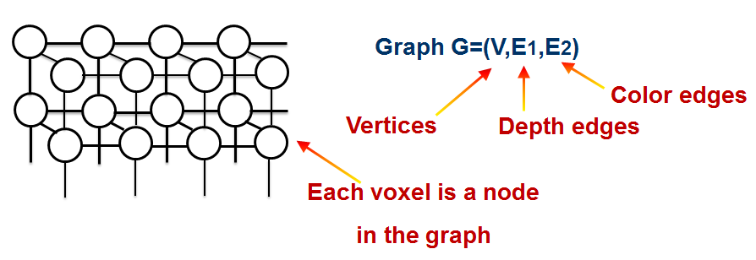
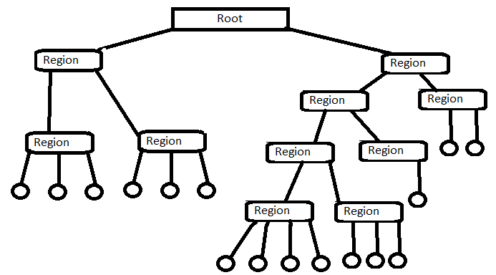
Algorithm
For each region of voxels, a branch is added with all of the voxel data, including the size, histogram, centroid, level, and area of each region. To save time, these are calculated during tree construction.

Slide 3
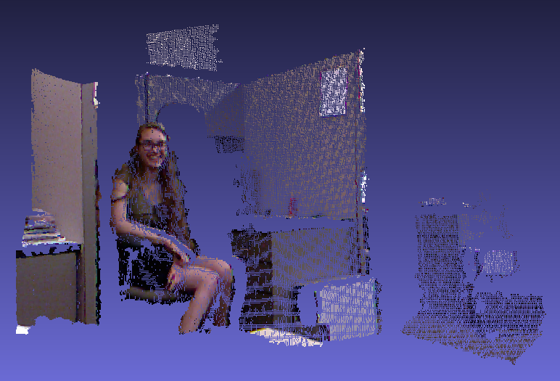
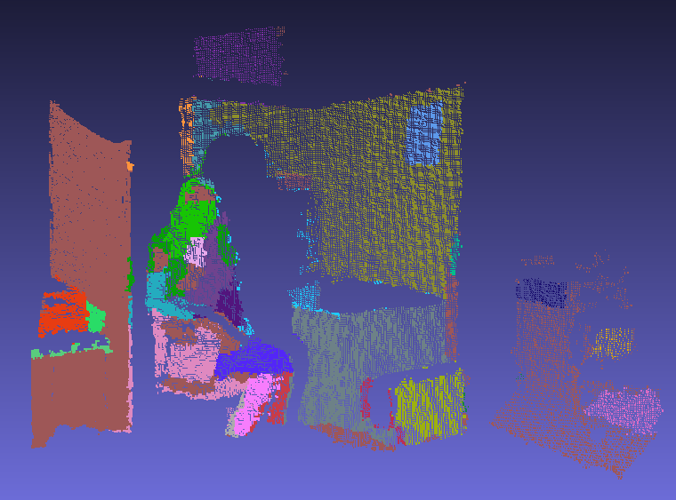
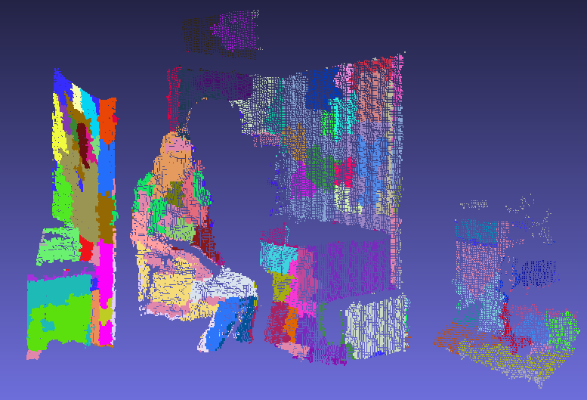
Results
Original
85% Level
65% Level
45% Level

