Slide 1
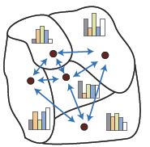
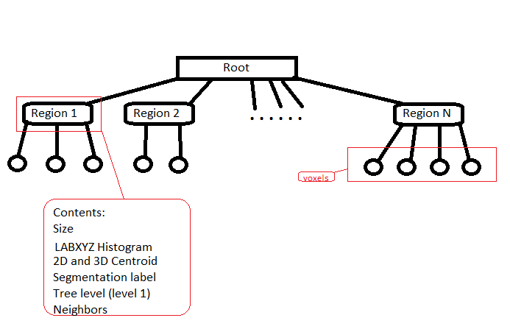
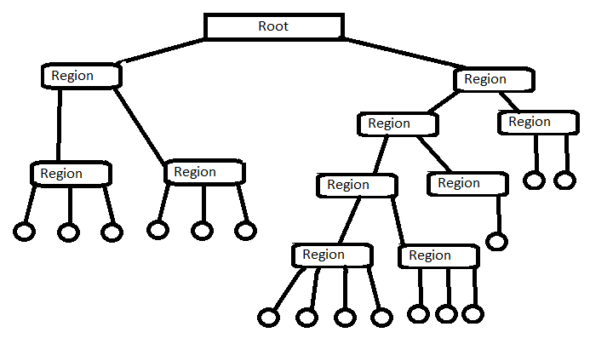
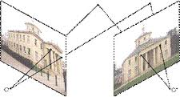
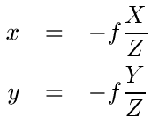
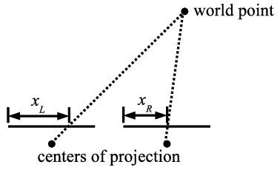
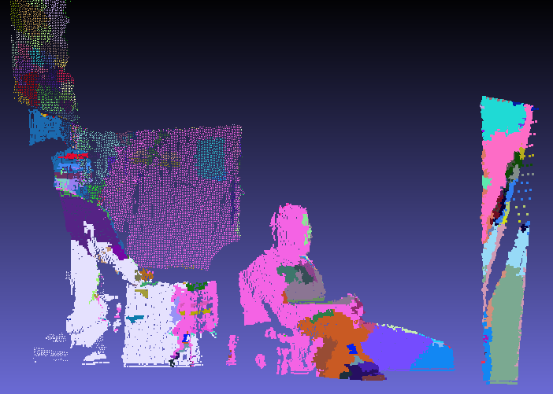
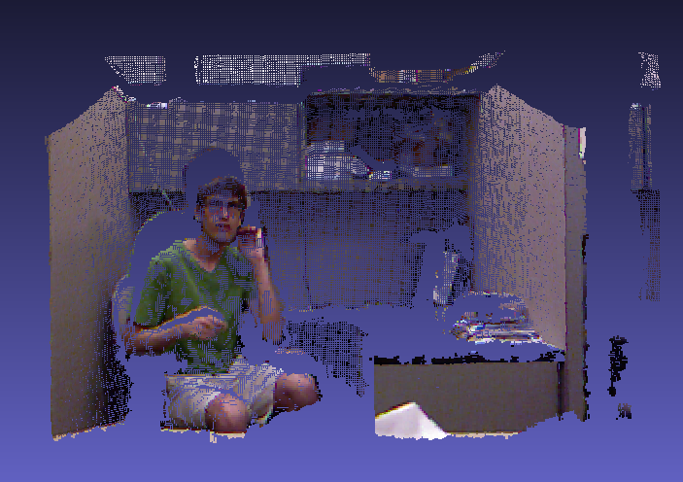
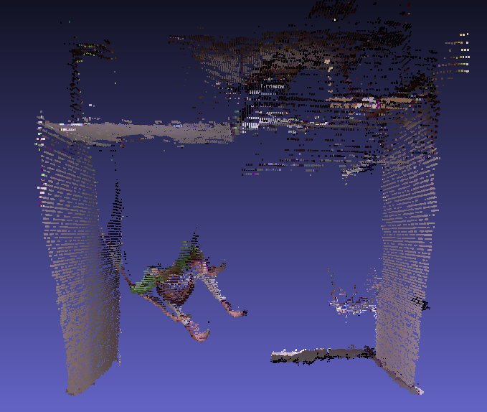
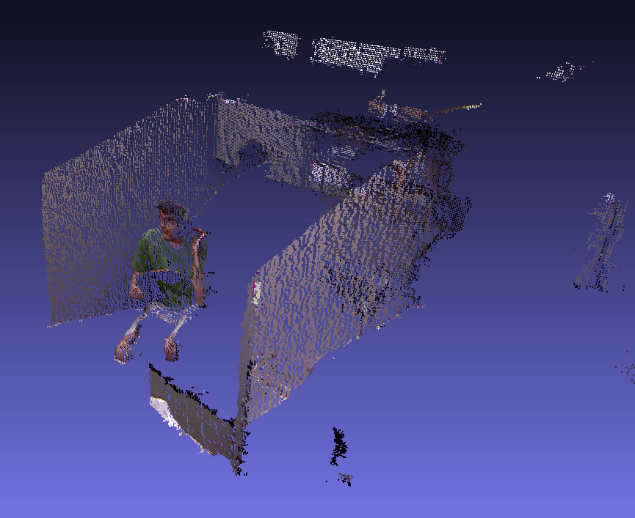
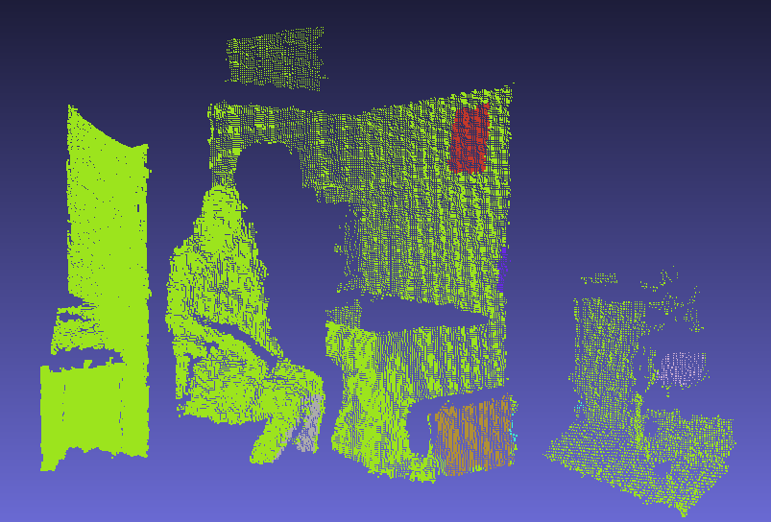
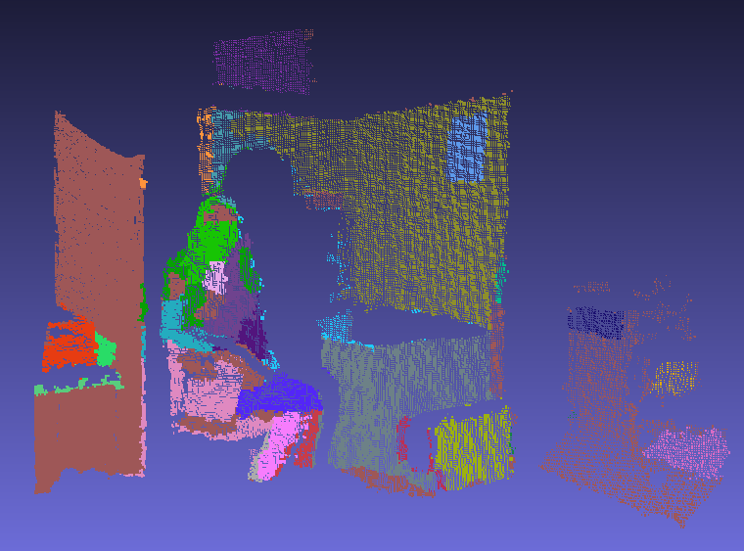
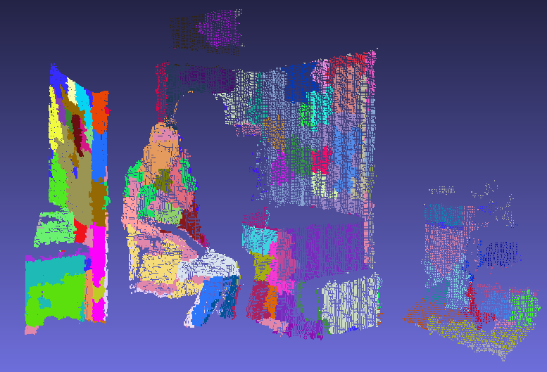
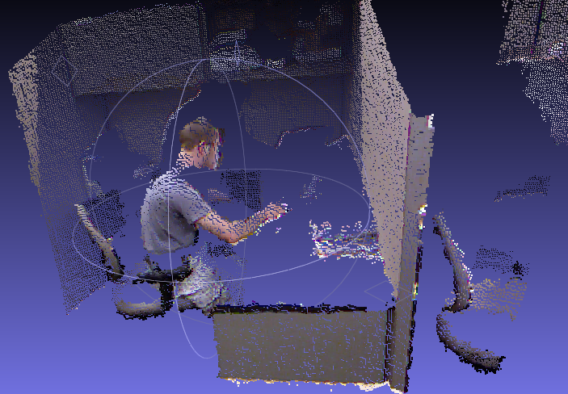
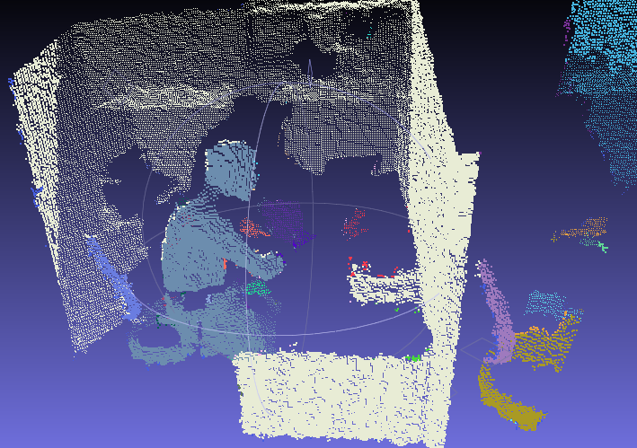
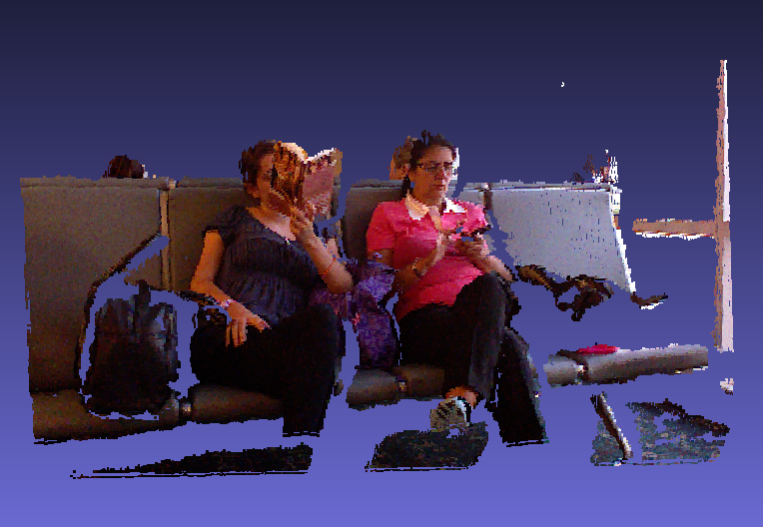
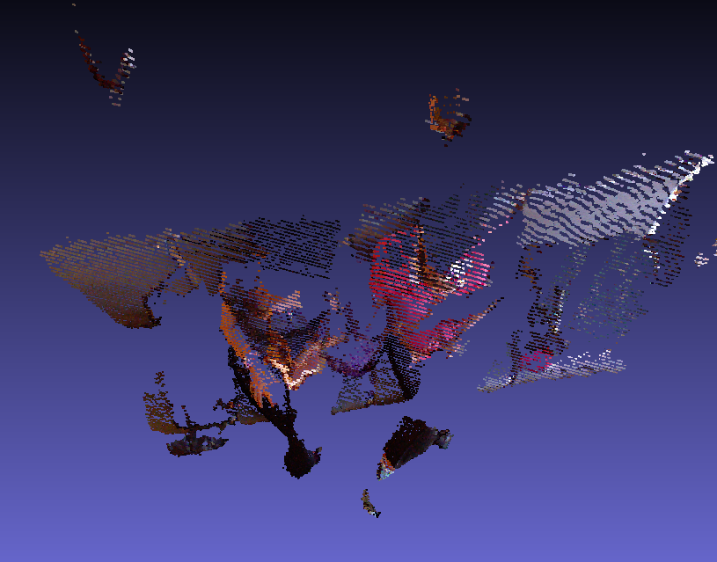
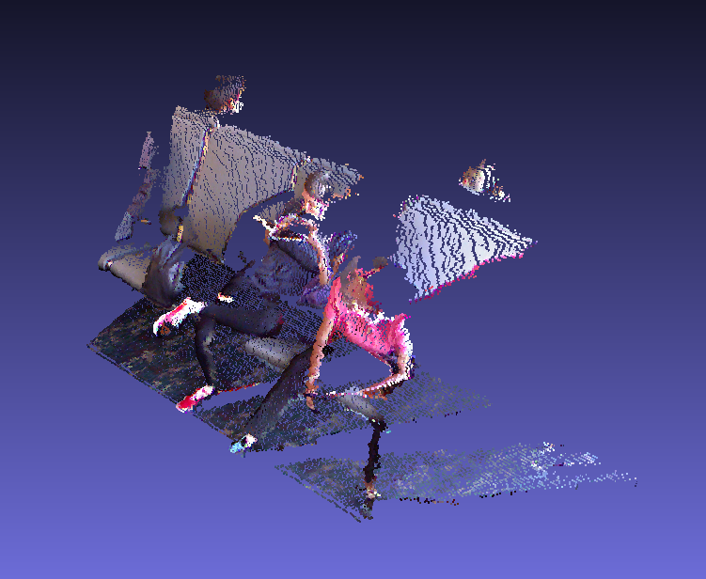
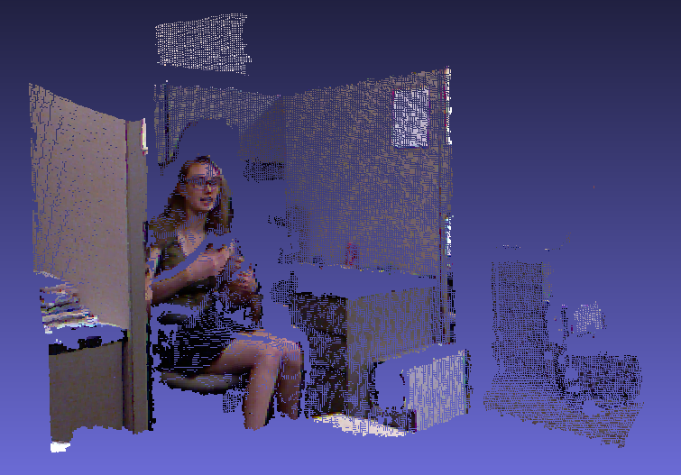
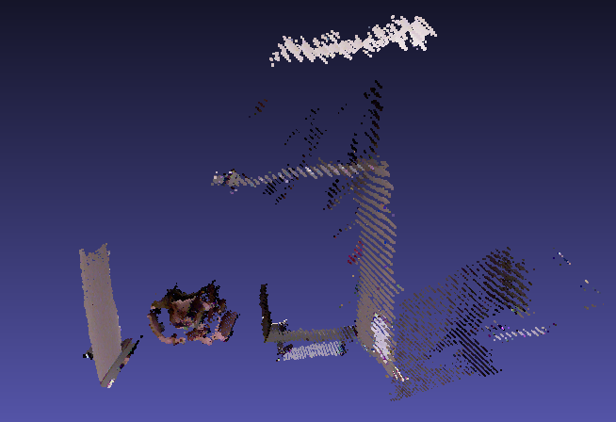
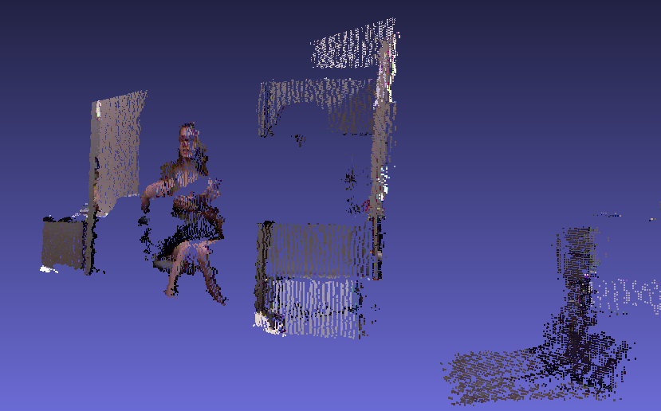
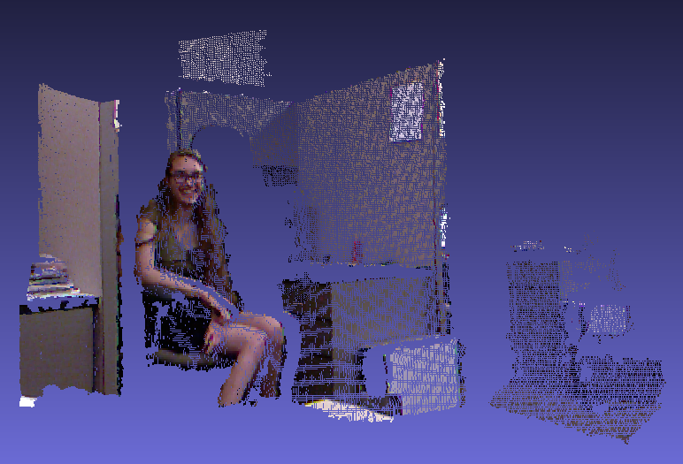
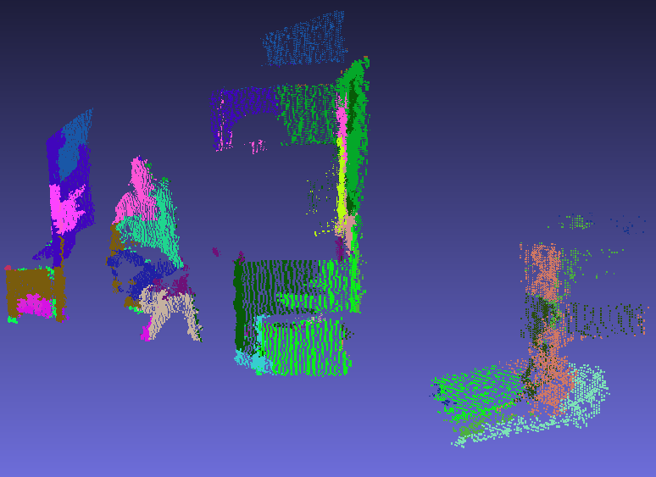
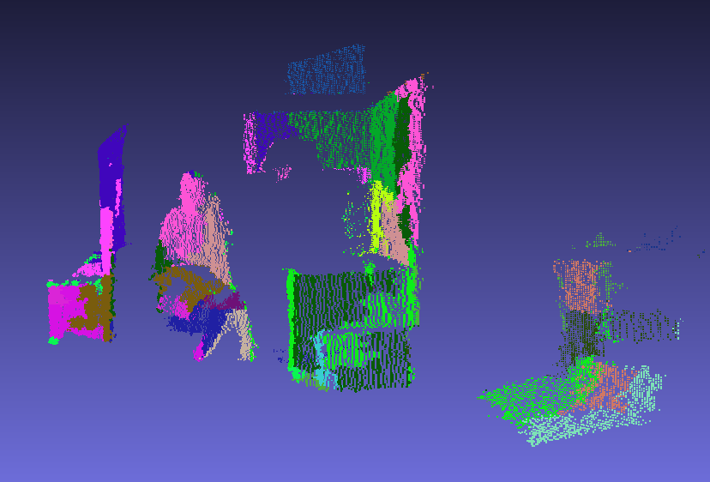
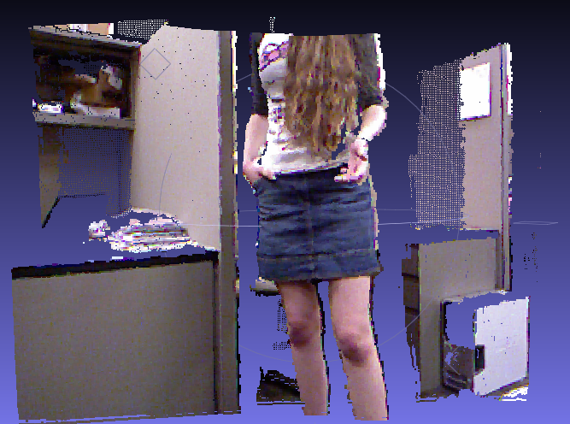
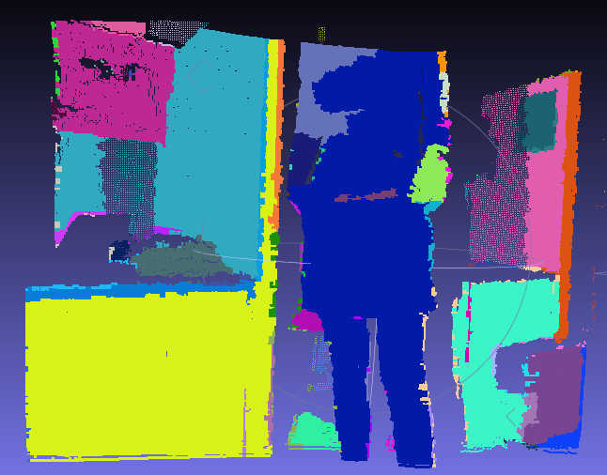
Efficient Hierarchical Graph-Based Segmentation of Spatio-Temporal Volumes Steven Hickson (shickso@clemson.edu), Gonzalo Vaca-Castano (gonzalo@knights.ucf.edu)
1 – Problem
Image and Volume Segmentation:
Group together similar pixels or voxels into regions that exhibit coherence, both spatially and visually.
Use both temporal and spatial information to improve segmentation.
Our Approach
Robust segmentation algorithm that uses 3D or 4D data (Microsoft Kinect data).
Novel hierarchical volumetric segmentation applicable to images, cloud points, and their temporal changes with no video length limit.
Highly efficient. Processing time for 4D data is near real time (~3 frames per second)
Applications: Object detection, activity recognition, and automatic selection of interesting objects.
3 – Graph Based Segmentation Theory
3 Stages of Segmentation Using Graphs
3.4 – Stage 3: Region Tree Based Segmentation
A region tree is constructed based on an over-segmented result of the 3D volume from Stage 2.
For each region of voxels, a branch is added with all of the voxel data, including the size, histogram, centroid, level, and area of each region. To save time, these are calculated during tree construction.
A Hierarchical region tree is then created by iteratively merging regions upwards in the tree based off the difference in the LABXYZ Histogram. This allows selection of a level of segmentation that can be specified with a single value.
Frames can be matched one at a time with the previous frame by a simple tree matching algorithm based off the stable marriage problem where each region is matched with the best region in the previous frame. This merges the regions over time.
Graph G=(V,E1,E2)
Color edges
Vertices
Depth edges
Each voxel is a node
in the graph
Given a graph G=(V,E1,E2), the minimum spanning tree is a set of edges such that
Resulting Graph is a Tree
The Sum of all Edge Weights is minimal
2 – Creation of 3D Data
Point Clouds in the form of PCD or PLY files are used for 3D Data.
Data generated by the Microsoft Kinect using the BLEPO library.
Uses a variant of multi-view geometry to match a depth and color image.
* Based on Pedro Felzenszwalb’s Efficient Graph Based Segmentation
3.1 – Multi-Stage Improvement
Without separating the first two stages (depth and color), the results are flawed as shown below.
Uses:
Current Segmentation
(From Stage 2)
Region Tree
Hierarchical Region Tree
Stereo Geometry
World Projection Parameters
4 – Results
Point cloud segmentation at different clustering levels
Spatio-Temporal Segmentation. (Temporal consistency)
3.2 – Graph Segmentation Stage 1: Depth
Stage 1 uses the depth information to make large segments differentiated by depth.
85% Level
65% Level
45% Level
3.3 – Graph Segmentation Stage 2: Color
Stage 2 uses the color information to make small segments within each depth segment.
Front Views
Top Views
Side Views
Original
Time Frame 1
Time Frame 15

