Slide 1
Potential Projects
RGBD gesture recognition with the Microsoft Kinect
Person recognition by parts

Slide 2
RGDB Gesture Recognition
Read through multiple papers and it seems like modifying existing algorithms based on Hidden Markov Models is the best way to go.
Most of the top performers of the ChaLearn Gesture challenge only used depth; however, improvements could be made by using depth and color (also upping the resolution to 640x480)

Slide 3
Getting Data from the Kinect
Although the ChaLearn database gives out some examples, they give an incorrect way to sync the depth and color image. Also they take images 320x240 when the Kinect can supply a higher resolution.
An alternative is to test on both the ChaLearn database and real samples

Slide 4
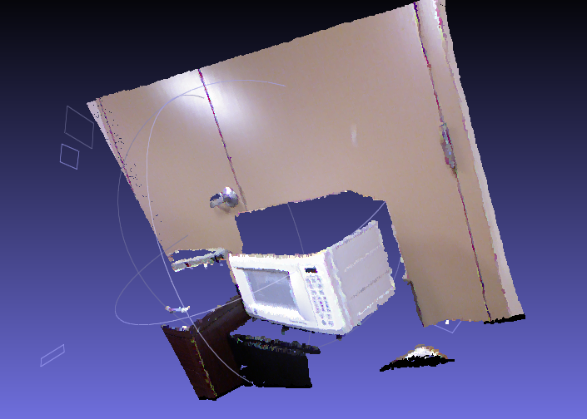
Constructing Point Clouds
Reconstructing Point clouds is just a matter of understanding multiple view geometry.

Slide 5
HMM Advantages
A Hidden Markov Model is a statistical system model that is a Markov process with hidden states.
HMM are often used in temporal pattern recognition and are useful for one-shot learning applications
The highest ranking winners of the first ChaLearn competition used HMM or CRF

Slide 6
Approach
Based off two papers:
A Hidden Markov Model-Based Continuous Gesture Recognition System for Hand Motion Trajectory
A Hidden Markov Model-Based Isolated and Meaningful Hand Gesture Recognition
To make the approach more novel, add and use identification of the parts of the body referencing the paper:
Real-time Identification and Localization of Body Parts from Depth Images

Slide 7
Person Detection by Parts
Based off the paper:
P. Felzenszwalb, R. Girshick, D. McAllester, D. Ramanan. Object Detection with Discriminatively Trained Part Based Models. TPAMI , Vol. 32, No. 9, September 2010.
This paper performed very well and could be drastically improved by specifying it to work with only people

Slide 8
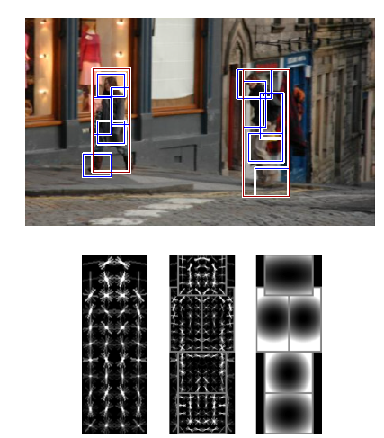
Method
Features are chosen with HOG using an enriched Dalal-Triggs Da detector based on star roots.
Training is done with a method called LSVM.

Slide 9
Databases to Test
The Pascal competition has test sets we can use
Improve the algorithm by training with only people and changing the root points to be specific to humans, giving higher weight to the head since it is rarely occluded.

Slide 10
Novel Improvements
Implement a new algorithm based off Felzenszwalb’s using time (video) or depth to improve the results
Add rotation as a parameter of the model
Model human activities based off the rotation and translation of the parts (this would only work on largely differing activities)
Change the detector to improve it. Options are including a weight for human skin color which is in a small region on the chromatic scale.

