Slide 1
REU Project
4D Efficient Real-Time Graph Based Temporal Point Cloud Segmentation
Steven Hickson

Slide 2
Current Method
Pros:
Fast, currently at 400 ms / frame
Can be run in real time (especially if we convert some code to CUDA)
Has no memory or video length limit, ie can run infinitely.
Cons:
Still not as accurate.
Re-labels segments if there is too much occlusion.
Still has 5 arbitrary values that determine the segmentation.
Over-reliant on the centroid, (this can be easily changed but needs to be experimented on.

Slide 3
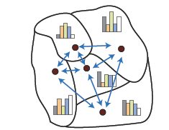
Hierarchal Region Trees
Whereas Georgia tech used Region Graphs, we use Region Trees, which are constructed using the labeled graph combined with the original point cloud data.
These are constructed with only one level, however, the tree can be made hierarchal by merging the tree upwards based off the LABD histogram difference between each region and its pre-computed neighbors.

Slide 4
Basic Region Tree

Slide 5
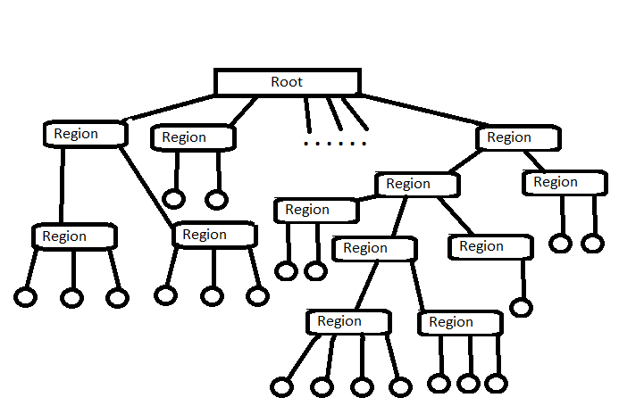
Propagated Region Tree

Slide 6
Benefits
No more arbitrary values. Only one user input, which determines which tree level is selected.
Better segmentation since the histogram of the region leads to a better estimation.
Robust and novel approach

Slide 7
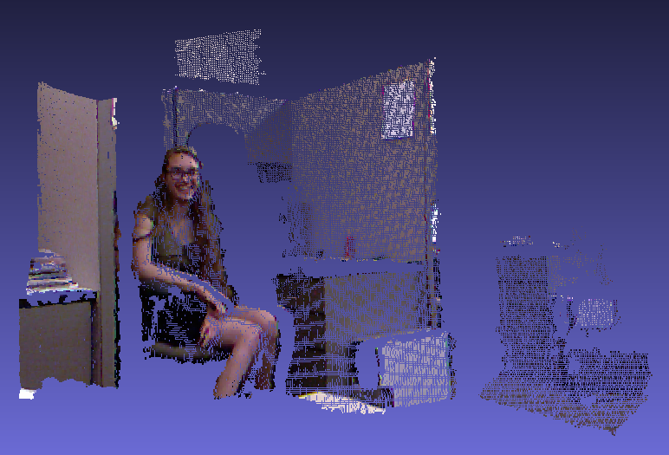
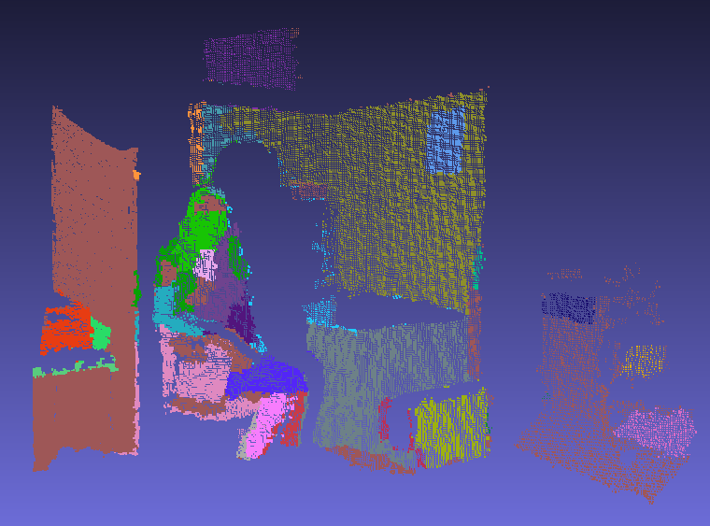
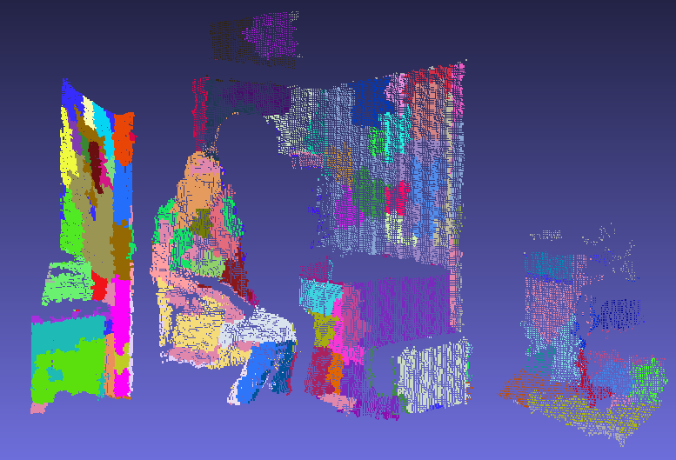
Results
Original
85% Level
65% Level
45% Level

