Slide 1
REU Project
Person Recognition with pose estimation using a part based pyramidal weighting scheme

Slide 2
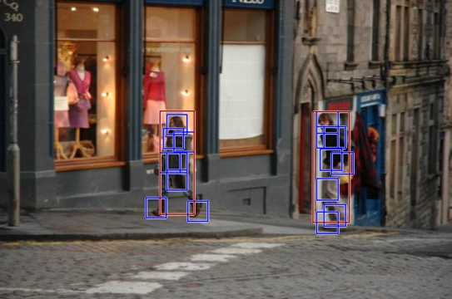
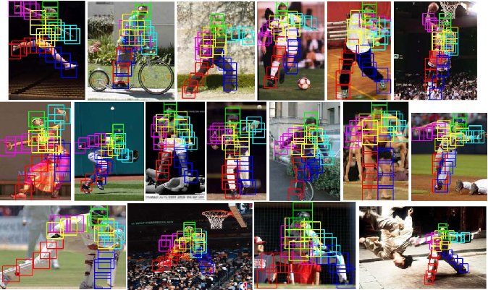
Original P. Felzenszwalb and D. Ramanan Results

Slide 3
Flaws and Fixes
New pose estimation code works badly with multiple people or people far away
Find a pyramidal weighting scheme based off the original Felzenszwalb code that finds all people, then use those locations to estimate the pose using Ramanan’s pose estimation code.

Slide 4
Results to Improve

