Slide 1
REU Project
RGBD gesture recognition with the Microsoft Kinect

Slide 2
ChaLearn Competition
20,000$ + up to 100,000$ prize in IP licensing
53 teams, 80 participants, 572 entries
One shot gesture learning
Can use depth and RGB.
Focused mostly on hand gestures but may include head movements or facial expressions
Rules: http://www.causality.inf.ethz.ch/Gesture/ChaLearnGestureChallengeOfficialRules12-5-11.pdf

Slide 3
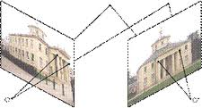
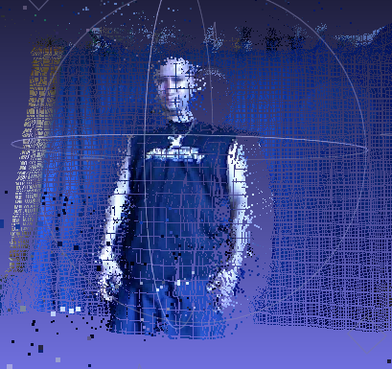
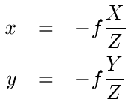
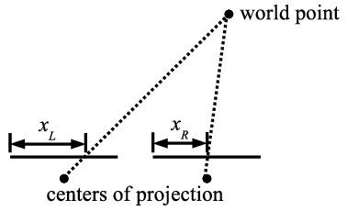
Constructing Point Clouds
Started constructing point clouds of Chalearn database using multiple view geometry and calibration parameters.

Slide 4
Approach
Implement Sapp algorithm
Change joint locations to 3D, change Sapp algorithm to take advantage of 3D information.
Enforce rigid joint constraints using proportions between joint distances.
Action recognition using chaotic invariance.

Slide 5
Sapp Results

