Slide 1
REU Project
Triplet Person Detection and Behavior Estimation
Steven Hickson

Slide 2
Papers
Dijkstra, J., A.J. Jessurun, and H.J.P. Timmermans. 2001. "A Multi-Agent Cellular Automata Model of Pedestrian Movement." In M. Schreckenberg and S.D. Sharma(ed.): Pedestrian and Evacuation Dynamics. Springer-Verlag, Berlin. pp. 173-18
Weina Ge; Collins, R.T.; Ruback, R.B.; , "Vision-Based Analysis of Small Groups in Pedestrian Crowds," Pattern Analysis and Machine Intelligence, IEEE Transactions on , vol.34, no.5, pp.1003-1016, May 2012
doi: 10.1109/TPAMI.2011.176
P. Felzenszwalb, R. Girshick, D. McAllester, D. Ramanan
Object Detection with Discriminatively Trained Part Based Models
IEEE Transactions on Pattern Analysis and Machine Intelligence, Vol. 32, No. 9, September 2010

Slide 3
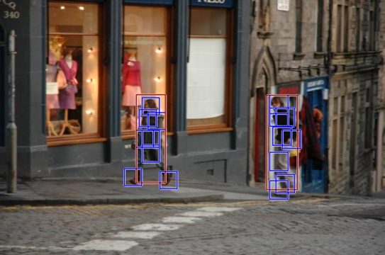
Original P. Felzenszwalb Results

Slide 4
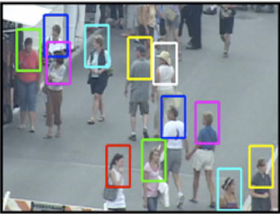
Competing Results

Slide 5
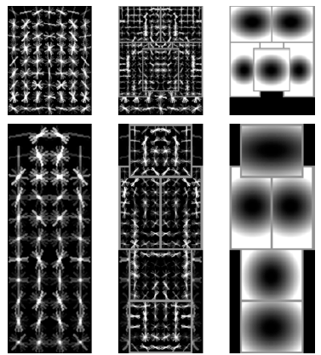
Current Code Changes
Changing Model

Slide 6
Next
Change Model fully to support finding triplets and test.
Implement smaller crowd based triplet model
Find behaviors

