Slide 1
REU Project
RGBD gesture recognition with the Microsoft Kinect
Steven Hickson

Slide 2
ChaLearn Competition
20,000$ + up to 100,000$ prize in IP licensing
53 teams, 80 participants, 572 entries
One shot gesture learning
Can use depth and RGB.
Focused mostly on hand gestures but may include head movements or facial expressions
Rules: http://www.causality.inf.ethz.ch/Gesture/ChaLearnGestureChallengeOfficialRules12-5-11.pdf

Slide 3
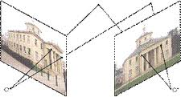
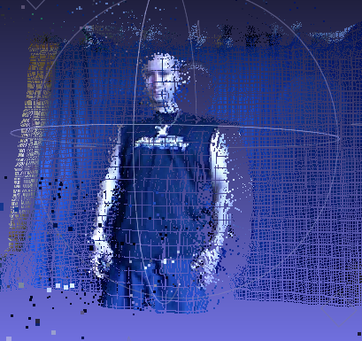
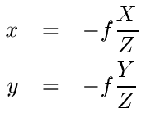
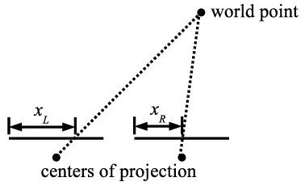
Constructing Point Clouds
Started constructing point clouds of Chalearn database using multiple view geometry and calibration parameters.

Slide 4
Approach
Implement New Pose Estimation algorithm
Change joint locations to 3D, change Pose Estimation algorithm to take advantage of 3D information.
Enforce rigid joint constraints using proportions between joint distances.
Action recognition, possibly using chaotic invariance.

Slide 5
Old Pose Estimation Results

Slide 6
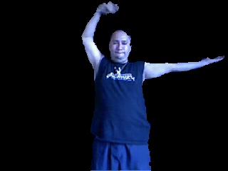
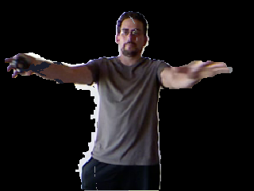
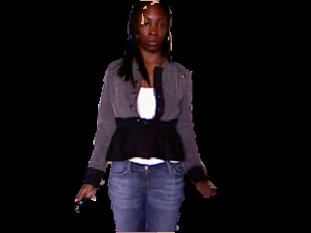
Efficient Temporal Graph Based Person Segmentation

Slide 7
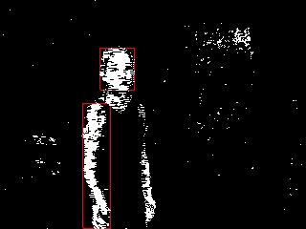
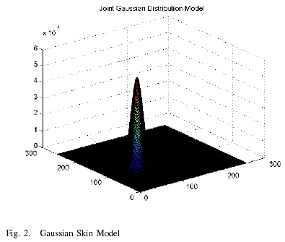
Skin Chromatic Segmentation and Hand Tracking
Takes advantage of human skin color and optical flow

Slide 8
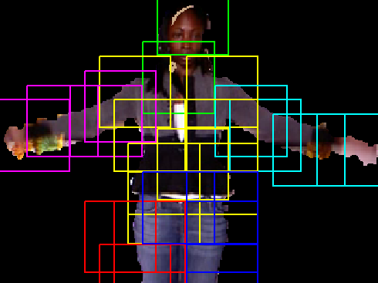
New Pose Estimation Results
Error Still Exists

Slide 9
Next: Skeleton Tracking
Change SkelTrack Library to work with out input and upper body images

