Slide 1
REU Project
4D Efficient Real-Time Graph Based Temporal Point Cloud Segmentation
Steven Hickson

Slide 2
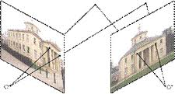
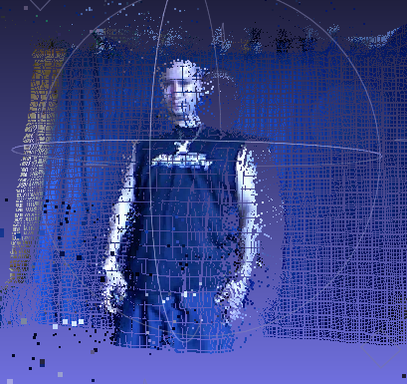
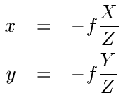
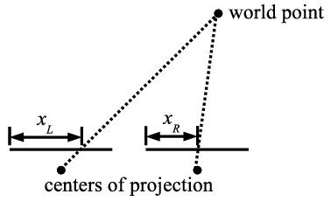
Constructing Point Clouds
Construction of Point Clouds using multiple view geometry and calibration parameters.

Slide 3
Graph Based Segmentation Theory
Graph G=(V,E)
...
vertices
edges
...
each pixel is a node
in the graph
Given a graph G=(V,E), the minimum spanning tree is a set
of edges such that
resulting graph is a tree
the sum of all the edge weights is minimal
Based of Pedro Felzenszwalb’s Efficient Graph Based Segmentation

Slide 4
Improvements
Take Graph in 3D but to save time and memory, do two 2D segmentations (one with depth, one with color).
Normalized, combined edge weights can cause problems. Implement multiple edge weights in order to be accurate.
Planar Segmentation with depth, than fine inner segmentation with color.
Include temporal information with optical flow, either by following the flow or adding a third weight
Increase the Graph to 4D for optical flow (two 3D segmentations)
Create minimum segment size specifications

Slide 5
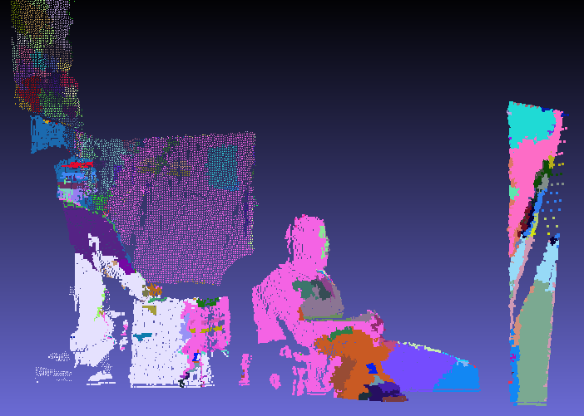
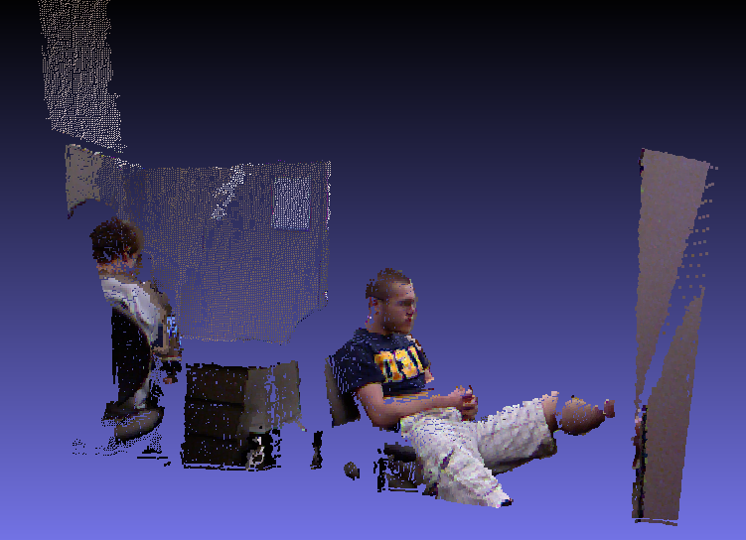
Color Only Results

Slide 6
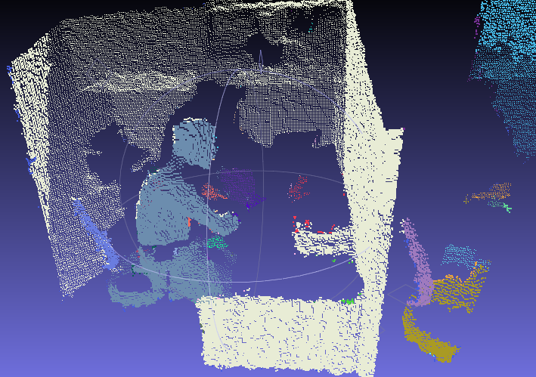
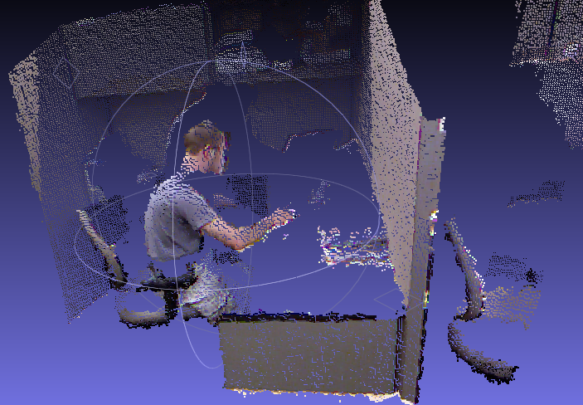
Depth Only Results

Slide 7
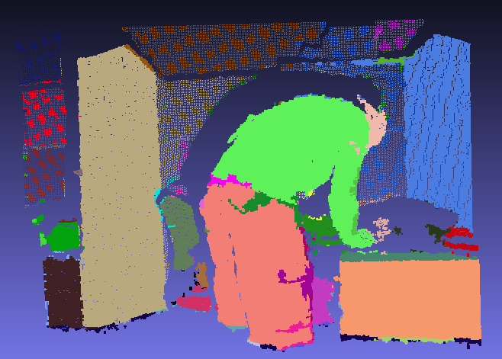
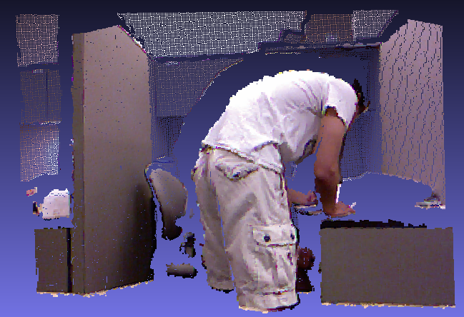
Current Results

Slide 8
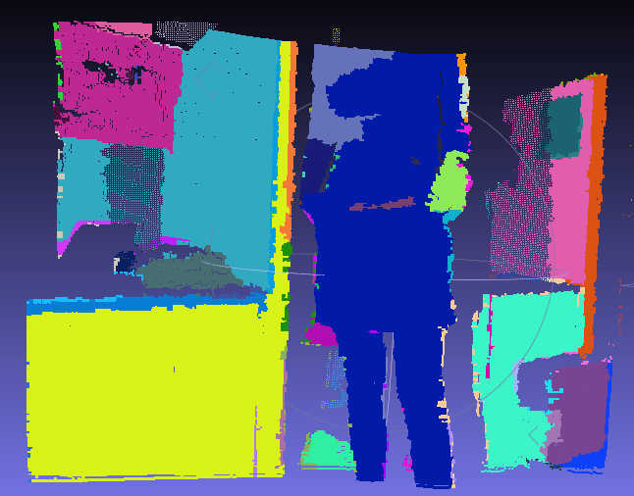
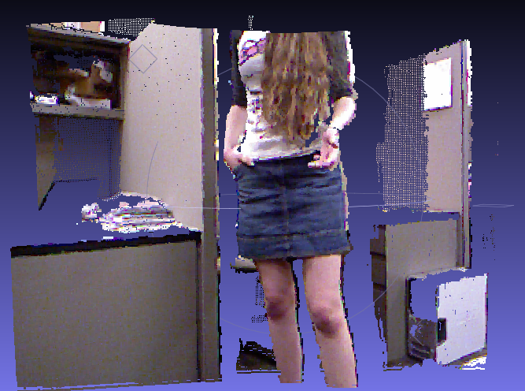
Current Results

Slide 9
Next
Temporal information and optical flow.
Overlapping time segments for graph merging.
CUDA for sorting and constructing the graph to reduce time (will have to be careful considering the large amount of memory required)

